Slide 1



GMOS:
A GEO Initiative to Support the Global Treaty
Nicola Pirrone
GMOS Coordinator
CNR – Institute of Atmospheric Pollution Research, Rome, Italy
GEPW-7
15-16 April 2013, Barcelona
CNR – Institute of Atmospheric Pollution Research, Rome, Italy
http://www.iia.cnr.it

Slide 2
GMOS Goal
To establish a Global Observation System for Mercury able to provide ambient concentrations and deposition fluxes of mercury species around the world, by combining observations from permanent ground-based stations, and from ad-hoc oceanographic and tropospheric measurement campaigns.
CNR – Institute of Atmospheric Pollution Research, Rome, Italy
http://www.iia.cnr.it

Slide 3
GMOS Overarching Objectives
To provide spatially and temporally distributed Hg speciated measurements aimed to understand the contribution of source regions vs. selected receptor areas with changing emission regime and meteorological conditions.
To validate regional and global scale atmospheric mercury modelling systems able to predict the temporal variations and spatial distributions of ambient concentrations of atmospheric mercury, and Hg fluxes to and from terrestrial and aquatic receptors.
To evaluate and identify source-receptor relationships at country scale and their temporal trends for current and projected scenarios of mercury emissions from anthropogenic and natural sources.
To develop interoperable tools to allow the sharing of observations and models output data produced by GMOS, for the purposes of research and policy development and implementation as well as support the achievement of goals of the Societal Benefit Areas (SBA) established in GEOSS.
CNR – Institute of Atmospheric Pollution Research, Rome, Italy
http://www.iia.cnr.it

Slide 4
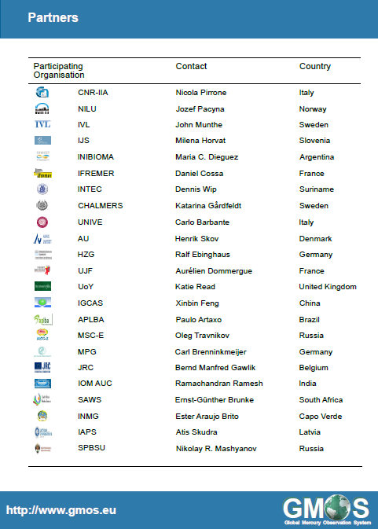
CNR – Institute of Atmospheric Pollution Research, Rome, Italy
http://www.iia.cnr.it

Slide 5
The International Framework
GEO Task HE-02 “Tracking Pollutants” - C1 “Global Mercury Observation System”
UNEP Mercury Program – Global Partnership on Atmospheric Mercury Transport and Fate Research (UNEP F&T)
Task Force on Hemispheric Transport of Air Pollutants (TF HTAP) under the UNECE-LRTAP international conventions.
Regional programs
CNR – Institute of Atmospheric Pollution Research, Rome, Italy
http://www.iia.cnr.it

Slide 6
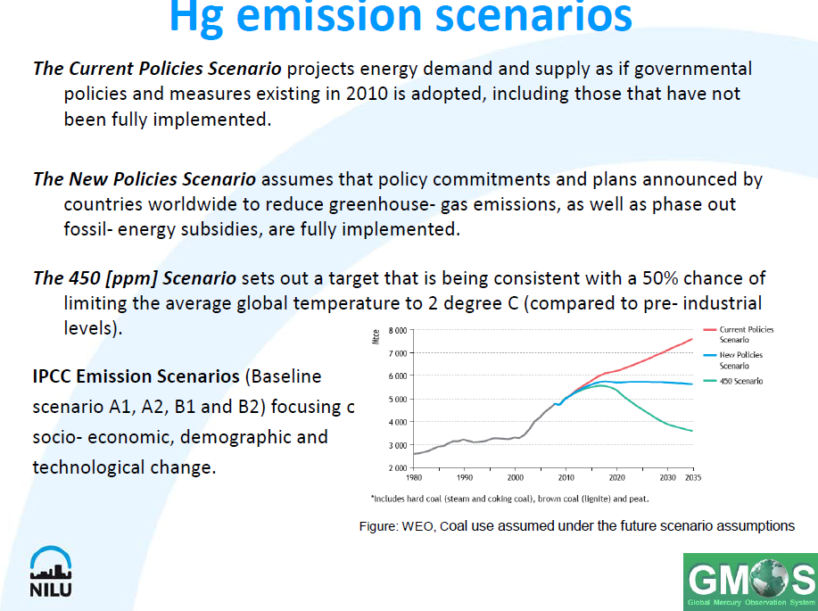
Current and Future Global Emissions
CNR – Institute of Atmospheric Pollution Research, Rome, Italy
http://www.iia.cnr.it

Slide 7
Global Mercury Observation System
The Ground-based observation system
The Marine Observation System
The Tropospheric Observation System
CNR – Institute of Atmospheric Pollution Research, Rome, Italy
http://www.iia.cnr.it

Slide 8
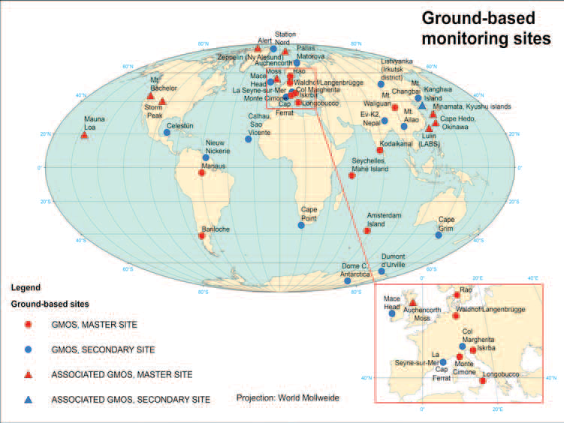
Ground-Based Observation System
CNR – Institute of Atmospheric Pollution Research, Rome, Italy
http://www.iia.cnr.it

Slide 9
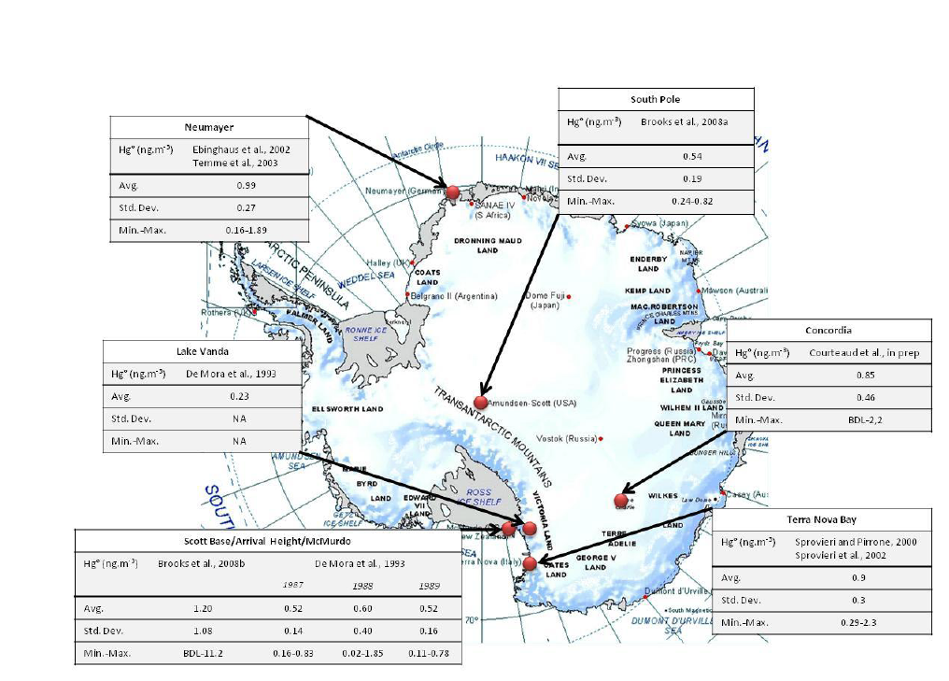
Ground-Based Observation System
CNR – Institute of Atmospheric Pollution Research, Rome, Italy
http://www.iia.cnr.it

Slide 10
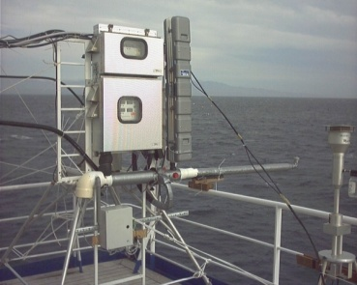
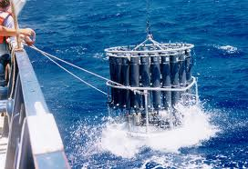
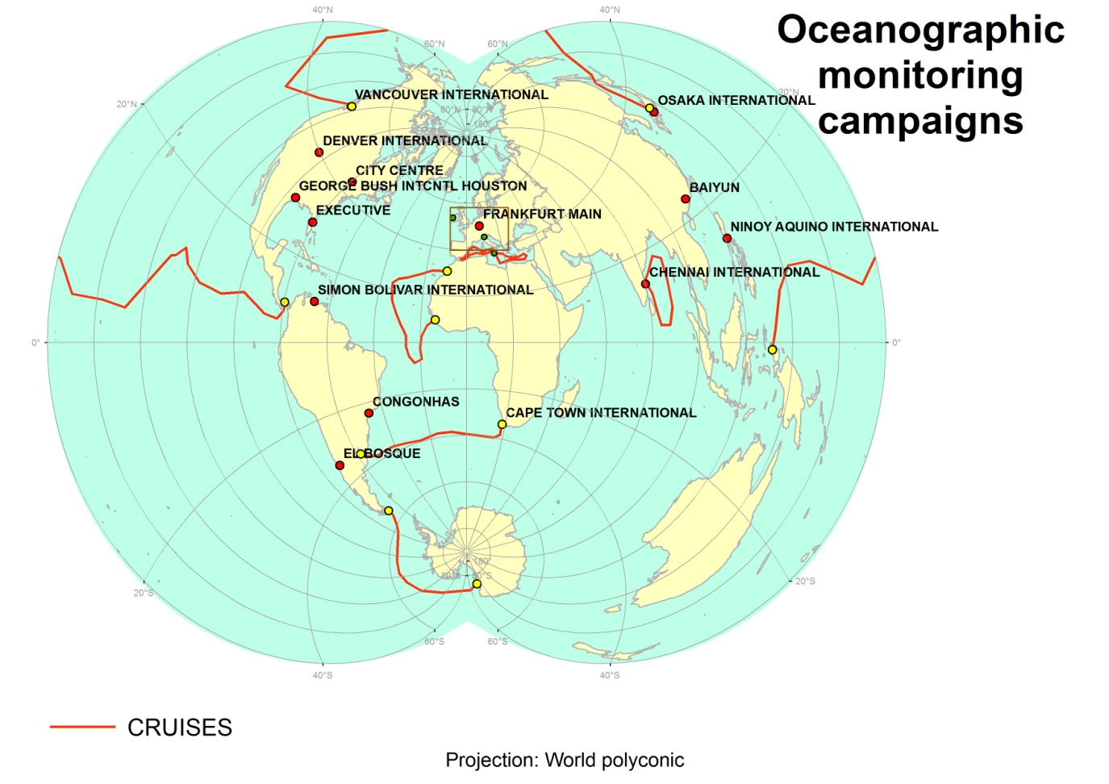
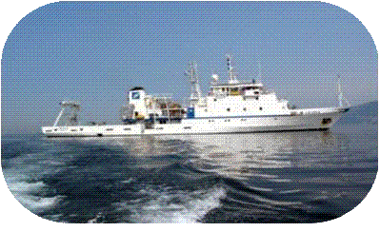
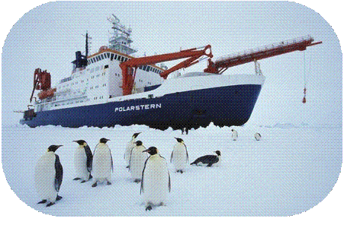
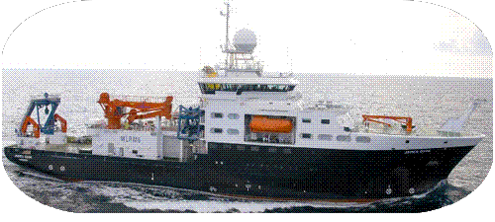
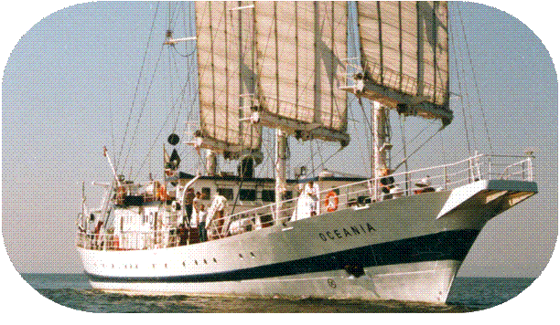
Oceanographic-Based Observation System

Slide 11
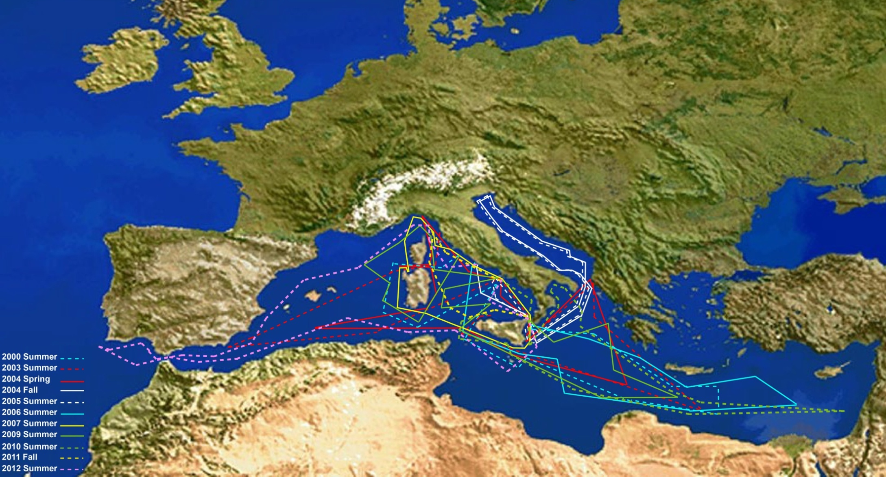
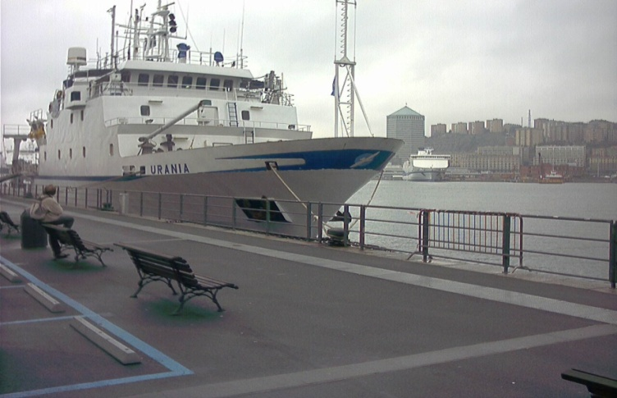
CNR – Institute of Atmospheric Pollution Research, Rome, Italy
http://www.iia.cnr.it

Slide 12
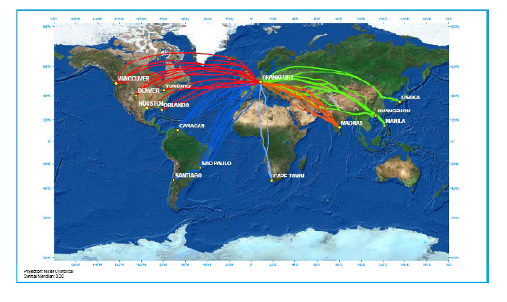
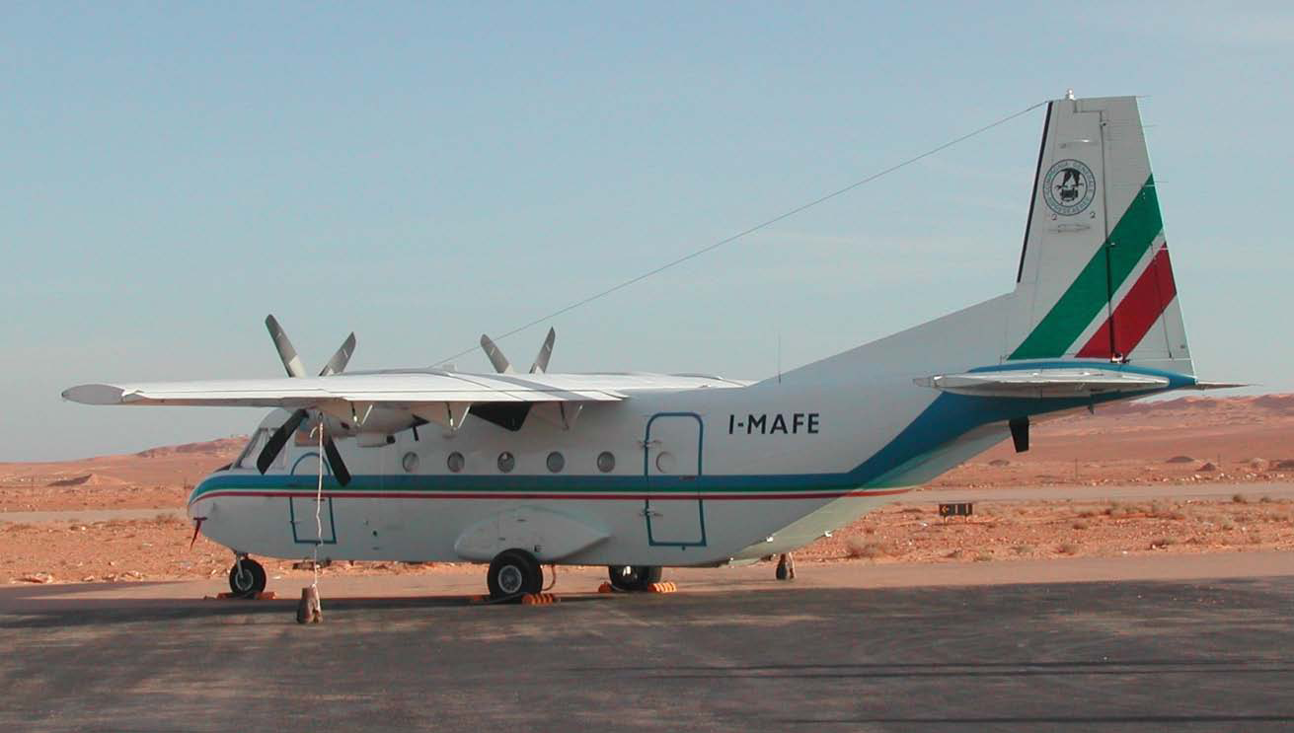
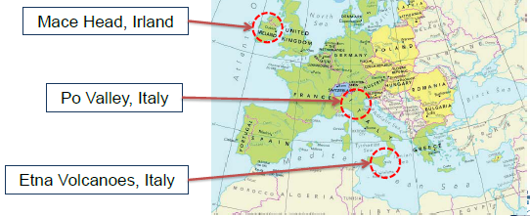
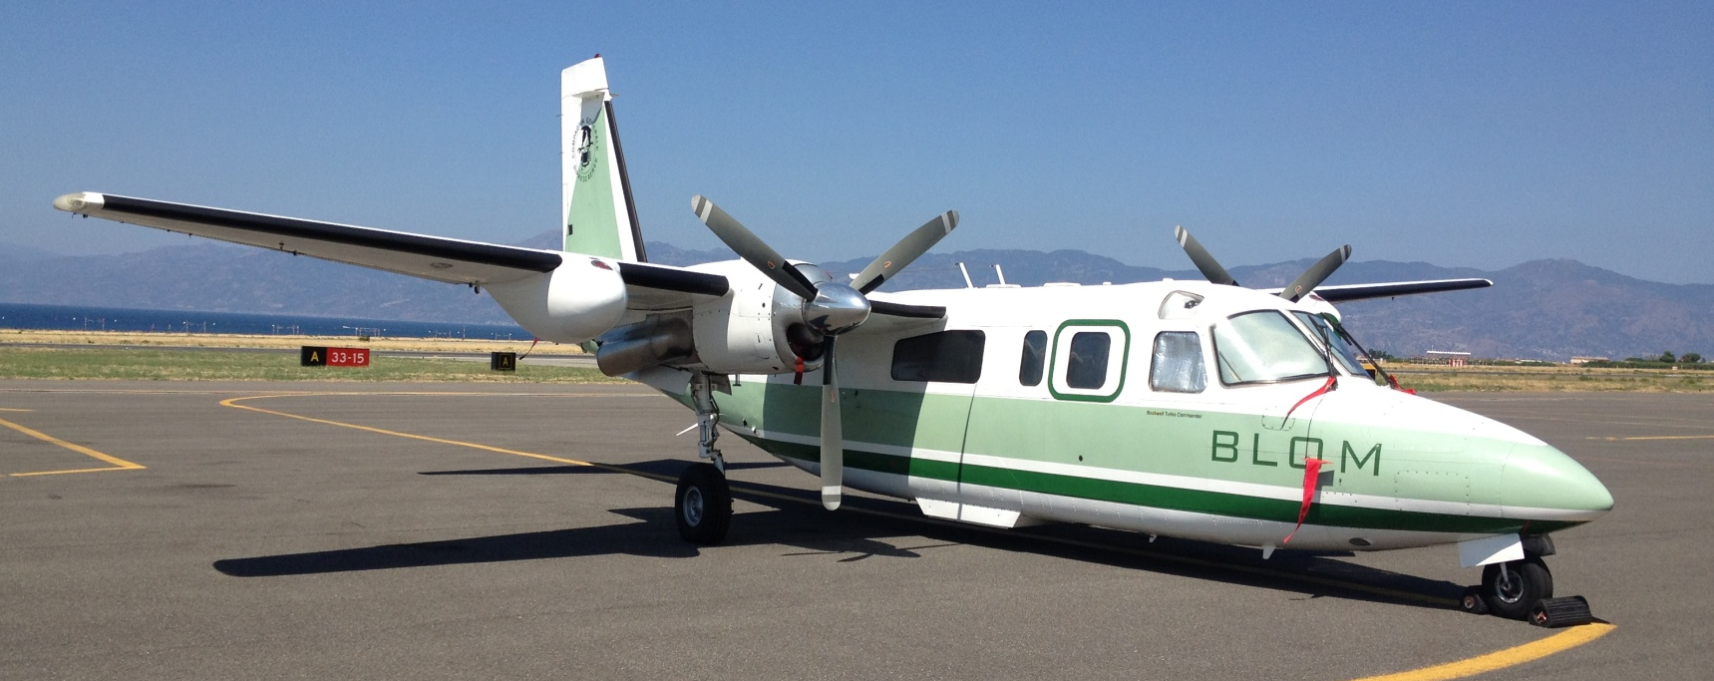

Aircraft-Based Tropospheric Program
CASA 212
Rockwell Turbo
CNR – Institute of Atmospheric Pollution Research, Rome, Italy
http://www.iia.cnr.it

Slide 13
Integration of GMOS with Other Programs
  U.S. NADP
  Environment Canada
  Ev-K2-CNR
  Norwegian University of Science and Technology (NTNU)
  NOAA
  USEPA-ORD
  Seychelles Bureau of Standards
  University of Washington-Bothell
  Cape Grim Science Program and Macquarie University
  Taiwan EPA and National Central University
  Desert Research Institute
CNR – Institute of Atmospheric Pollution Research, Rome, Italy
http://www.iia.cnr.it

Slide 14
GMOS Data Policy Document
Purpose: Provide guidance for both creators and users of GMOS datasets so as to promote data sharing within and beyond GMOS.
Developed within the framework of the GEOSS Data Sharing Principles.
CNR – Institute of Atmospheric Pollution Research, Rome, Italy
http://www.iia.cnr.it

Slide 15
GMOS Data Policy Document
What datasets are covered?
  Historical and current measurements from:
  ground-based monitoring sites
  oceanographic campaigns
  aircraft campaigns.
  Model output from regional and global models that are being run in support of GMOS.
What is the content of the DPD?
  Definitions of key terms
  Description of the GMOS Spatial Data Infrastructure (SDI)
  Conditions of use for data creators and data users
    How to submit/access data and metadata
    Data storage and availability
    Embargo periods and License agreements
    Acknowledgements in publication
CNR – Institute of Atmospheric Pollution Research, Rome, Italy
http://www.iia.cnr.it

Slide 16
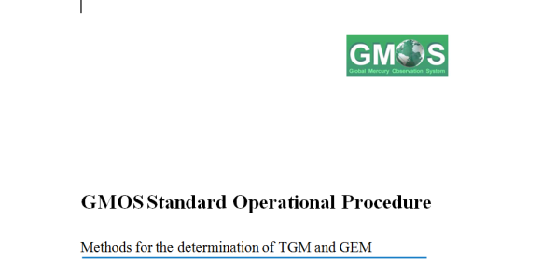
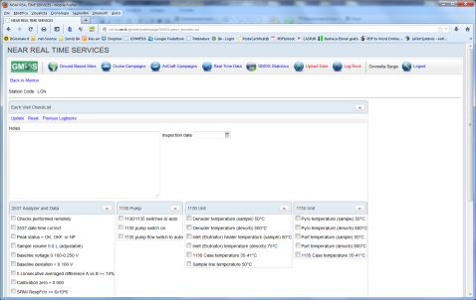
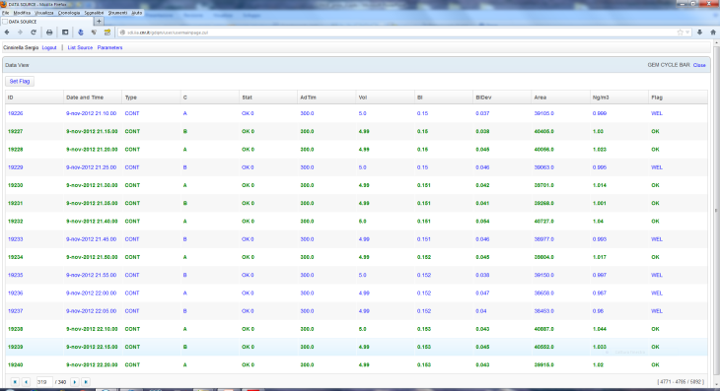
GMOS QA/QC Management System
SOPs
raw data dB
e-logbook
QA/QC
QA/QC dB
CNR – Institute of Atmospheric Pollution Research, Rome, Italy
http://www.iia.cnr.it

Slide 17
GMOS Data Policy & QA/QC
  Workshop on QA/QC
  planned for 10-12 June 2013 in Rome
CNR – Institute of Atmospheric Pollution Research, Rome, Italy
http://www.iia.cnr.it

Slide 18
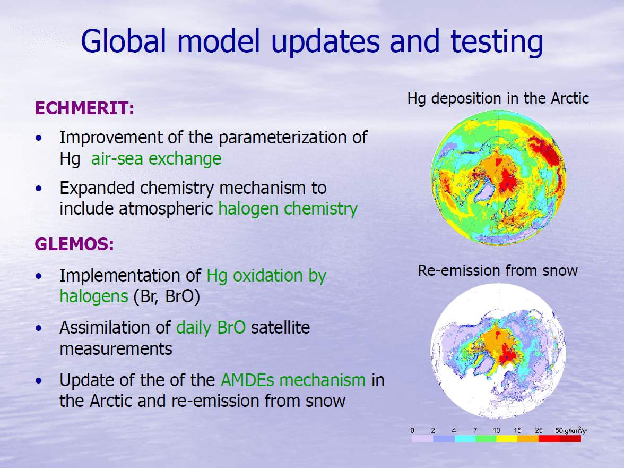
Global Scale Atmospheric Modeling
CNR – Institute of Atmospheric Pollution Research, Rome, Italy
http://www.iia.cnr.it

Slide 19
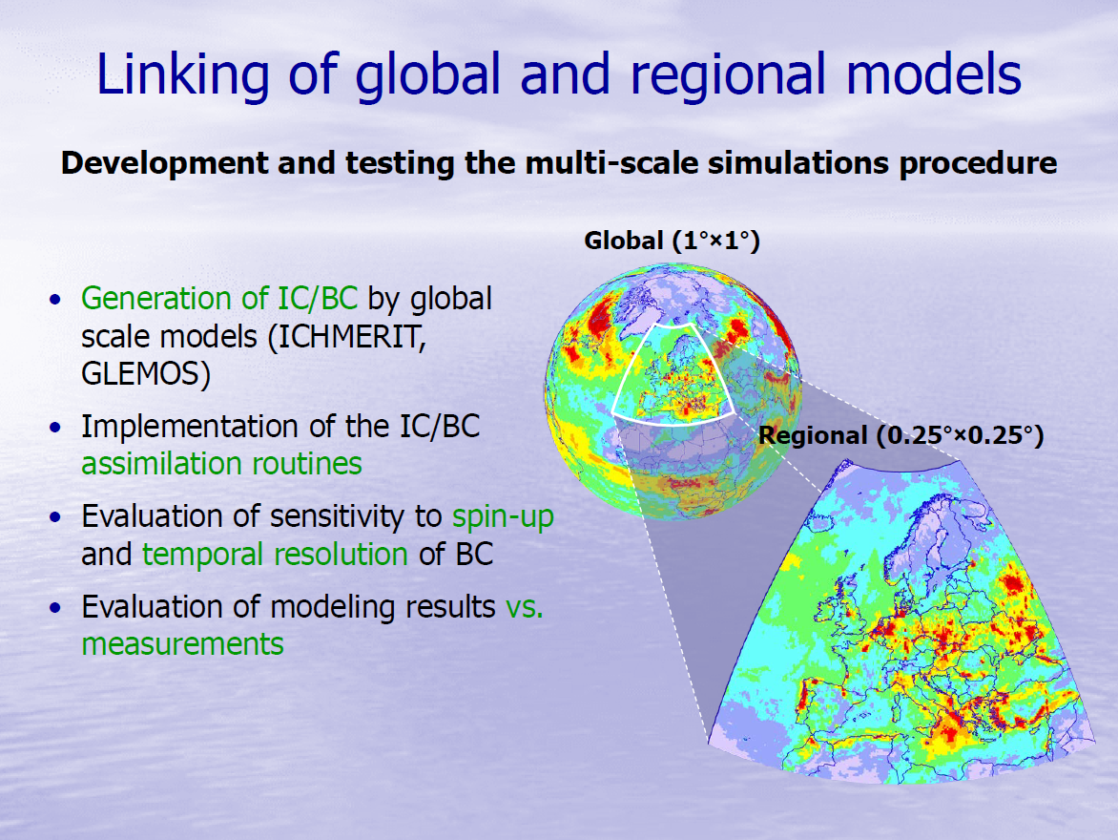
Global Scale Atmospheric Modeling
CNR – Institute of Atmospheric Pollution Research, Rome, Italy
http://www.iia.cnr.it

Slide 20
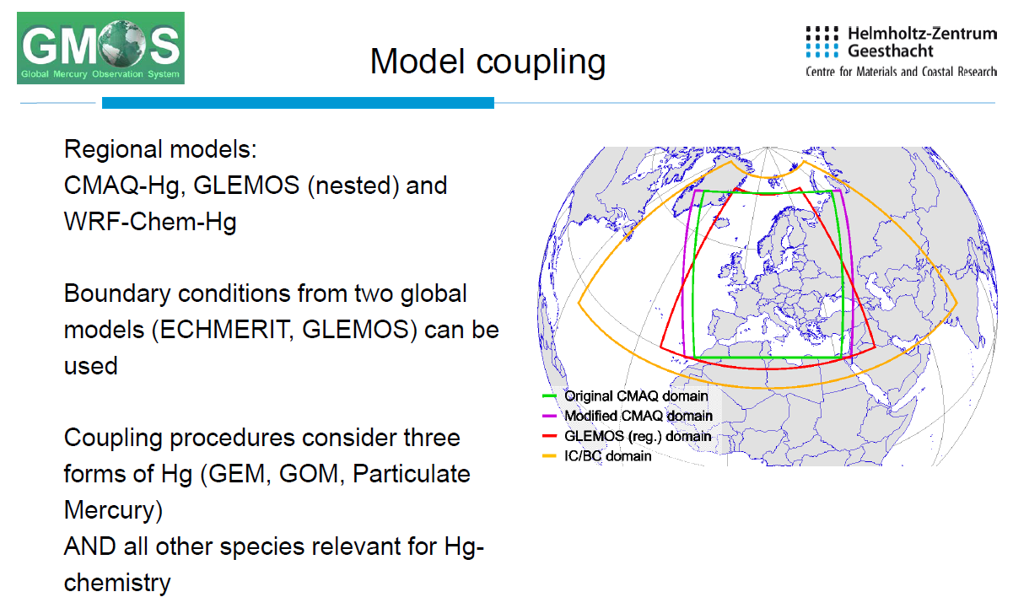
CNR – Institute of Atmospheric Pollution Research, Rome, Italy
http://www.iia.cnr.it

Slide 21
GMOS Spatial Data Infrastructure
The SDI may provide downstream services and tools to scientific data-users and policy makers.
Step1: Retrival of historical data sets
CNR – Institute of Atmospheric Pollution Research, Rome, Italy
http://www.iia.cnr.it

Slide 22
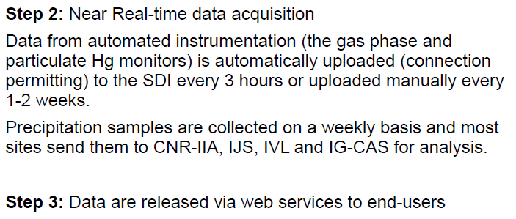
GMOS Interoperable System
CNR – Institute of Atmospheric Pollution Research, Rome, Italy
http://www.iia.cnr.it

Slide 23
The GMOS-CI

Slide 24
The GMOS-CI
Ground-based sites
Current data providers
Aircraft campaigns
Cruise campaigns

Slide 25
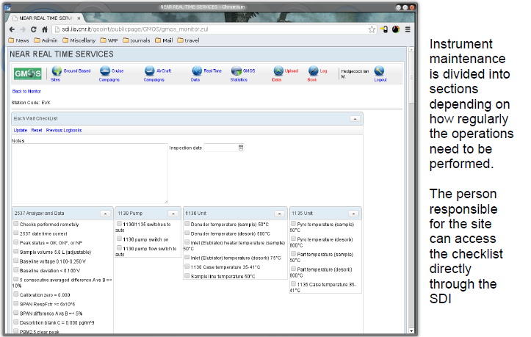
SDI Control
CNR – Institute of Atmospheric Pollution Research, Rome, Italy
http://www.iia.cnr.it

Slide 26
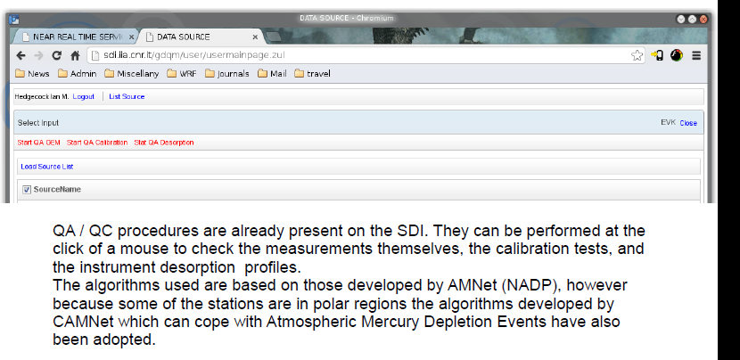
SDI Control
CNR – Institute of Atmospheric Pollution Research, Rome, Italy
http://www.iia.cnr.it

Slide 27

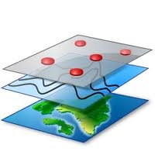


GMOS Interoperable System
Data Storage Layer
Application Layer
Business Logic Layer
Interfaces
WFS
Desktop GIS
Service broker
Geo-database
Map server
WMS
Catalog server
Thesaurus
WCS
WebGis
GeoInt
CSW
File system
User-interface
CNR – Institute of Atmospheric Pollution Research, Rome, Italy
http://www.iia.cnr.it

Slide 28
More about GMOS at...
www.gmos.eu
the official GMOS web portal provides all the information concerning the project development, interoperable system, field campaigns, atmospheric modelling and major findings, publications, and press releases
Thanks…..
CNR – Institute of Atmospheric Pollution Research, Rome, Italy
http://www.iia.cnr.it

