Slide 1




Enhancing African EO capacities for Agriculture and Forestry management: the AGRICAB project
T. Jacobs, C. Tote

Slide 2
Outline
Background: a “family” of Africa EO projects/partnerships
Concept
AGRICAB results & upcoming work:
  GEONETCast reception stations
  Training & software
  Integrated applications: national use cases
Contributions to GEO(SS)

Slide 3



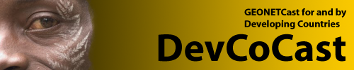




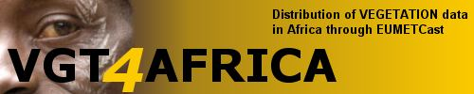
Background
GMFS – Global Monitoring for Food Security
  2003 – 2013, Operational Services
  Early Warning, Agricultural monitoring, CFSAM
  Focus countries: Senegal, Moz., Ethiopia, Zimbabwe, Niger, Sudan, Malawi
JRC MARSOP - Agriculture monitoring via RS
VGT4Africa (FP6-SPACE), 2005-2008
DevCoCast (FP7-ENV, mid 2008 – Q1 2012)
GEOLAND2 (FP7-SPACE, 2009-2012)
  Moved to Copernicus Global Land
AGRICAB (FP7-ENV, Oct 2011-Mar 2015)
  Focus countries: Kenya, Moz, S-Africa, Senegal, Tunisia
ISAC (FP7-SPACE, 2011-mid 2013, Ethiopia)
e-AGRI (FP7-ICT, Morocco, Kenya)
… and many more

Slide 4
Project concept
Community of practise
Engage Policy organizations
Component 3
Stimulating the uptake of EO techniques
Organize 5 regional & national stakeholder workshops
Support Master students, PhD’s
Livestock, statistics,
early warning, crop yield
Component 2
Predictive models and use cases
Forests & fire mapping
Statistics,
early warning, crop yield
Irrigation
Livestock, statistics,
early warning, crop yield
Use cases
Kenya
Use cases
Southern
Africa
Use cases
Mozambique
Use case
North
Africa
Use cases
Senegal,
Niger
Short-term trainings in Europe
Integrate & further develop tools
Component 1
Sustained provision of EO data and tools
Conduct 2 GEONETCAST Workshops & develop training material
Operate LandHub, establish & operate help desk
Continue product dissemination from DEVCOCAST, expand with DEIMOS, CBERS, other products

Slide 5
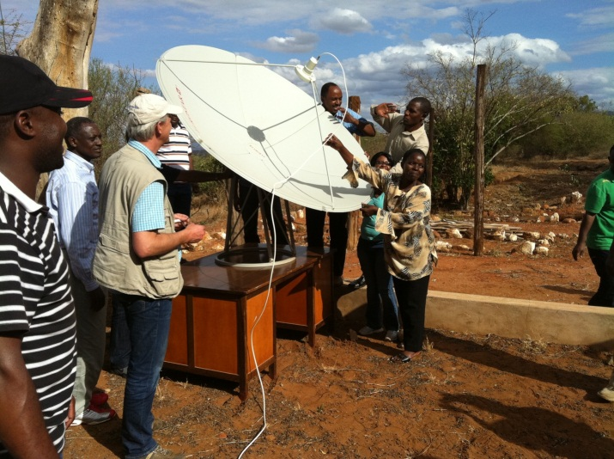
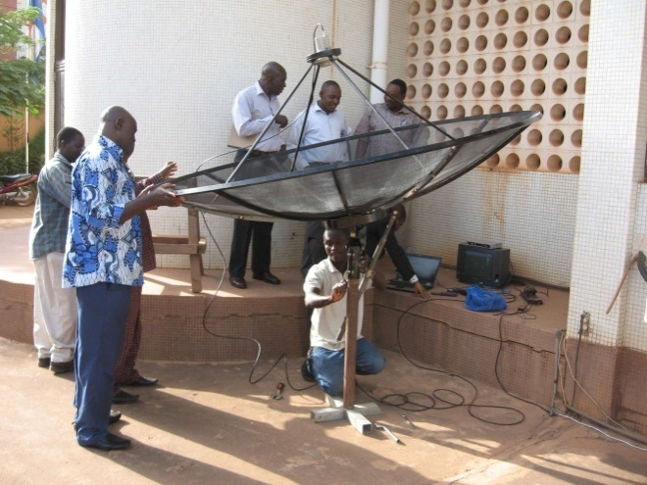


Setting up low cost GEONETCast receivers
Setup at training workshops in 2012:
  Kenya Wildlife Service, Voi, Kenya
  International Institute for Water and
  Environment Engineering (2iE),
  Ouagadougou, Burkina Faso
National network of GNC stations
in Ethiopia:
  Funded by UN-WFP office
  Supported by training staff
June 2013: receiver at OSS, Tunisia

Slide 6
Training & workshops so far
Tailored training in Europe
Broad-scaled, international workshops on GEONETCast and free processing software
  June 2012, Nairobi, Kenya
  Nov 2012, Ouagadougou, Burkina Faso
Working with dedicated teams in national workshops:
  E.g. crop production workshops in Mozambique and Senegal, in collaboration with GMFS project
  Builds on pre-existing Senegalese multi-disciplinary workgroup (GTP)
Support to
  Higher education
  AMESD System Administrators (training @ VITO)

Slide 7
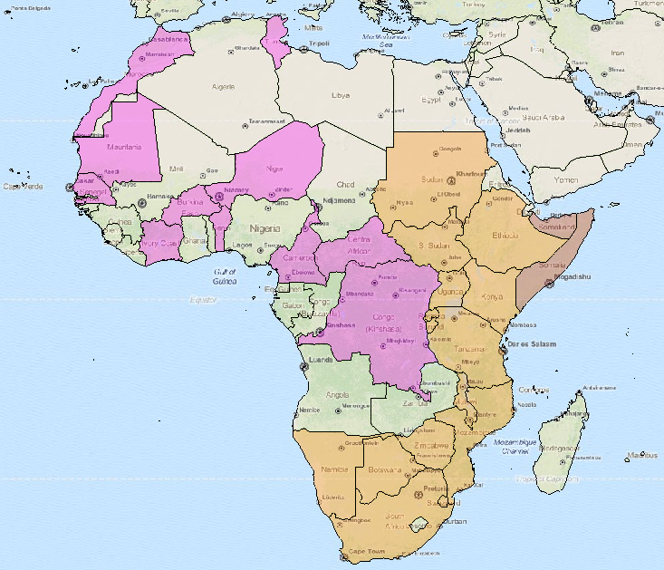
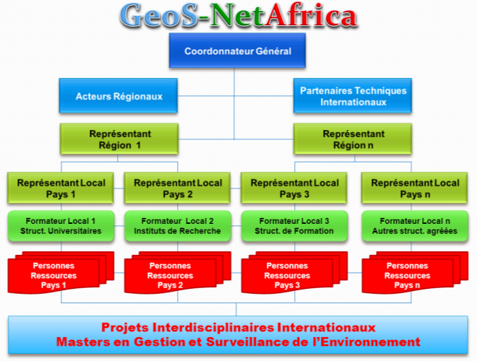
Training user communities - example
50+ participants at regional GNC
workshops
All countries in region, with emphasis
on AGRICAB focus countries
Mix of higher education, research
and operational institutes
Incl. participants from existing networks:
e.g. AMESD, ACF NGO, OSFAC
Encouraged the start-up of GeoS-NetAfrica
network: multi-disciplinary, driven by Africans

Slide 8
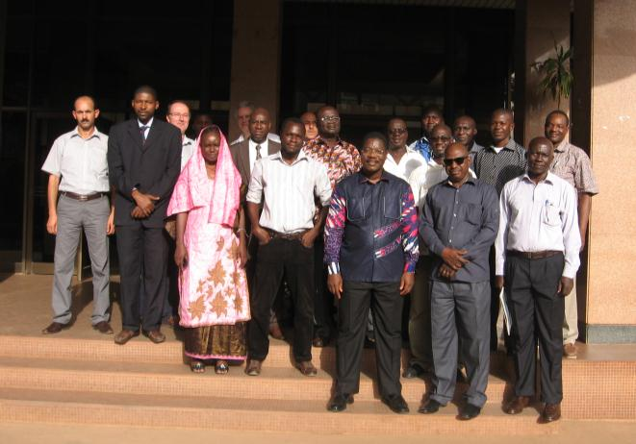
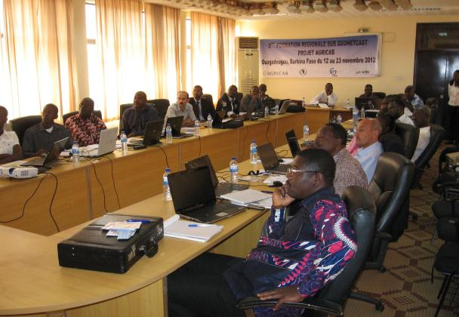
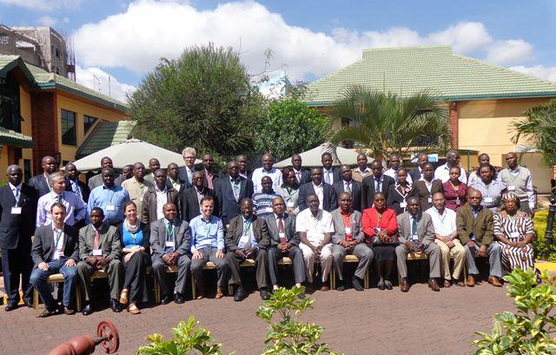
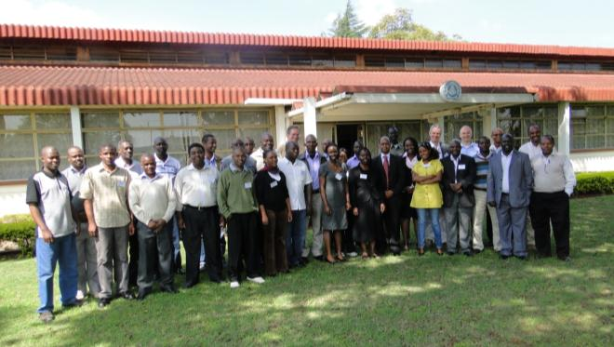
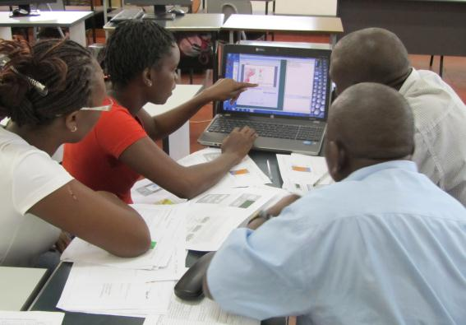

Slide 9
Upcoming workshops
National WS: linked to use case development
Regional WS: Bringing national results to regional level
    3 regional thematic workshops (OSS, AGRHYMET, RCMRD) in 2013
    2 regional thematic workshops in 2014
GEO workshop in Africa, 2014

Slide 10
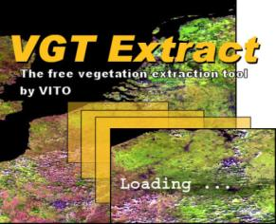


Supporting user communities: software
ITC/52N
ILWIS + Toolboxes
INPE
Terra-Amazon
(GeoDMA)
VITO
VGTExtract
SPIRITS
Updates to existing software:
  E.g. VGTExtract utility, ILWIS + toolboxes
Focus on time series processing:
  E.g.
  initially developed by VITO for
Inter-linking existing tools

Slide 11




Use cases (1/3): Crop production systems
Agro-meteorological Modeling
Agricultural statistics
Early warning and
crop mapping
Irrigation agriculture
Use cases in
Kenya
Senegal
Mozambique
Use case in
North Africa

Slide 12
Agricultural statistics
EO for more cost-effective, high quality crop area estimates
Needs to be tested, incl. comparison of different approaches
Combination of:
Ground survey (points or areas)
Airborne campaign
High resolution satellite imagery (SPOT5 / RapidEye)

Slide 13
Agro-meteorological modeling
Quantitative weather and crop monitoring and crop yield forecasting
Approach:
  Set-up weather data infrastructure (level 1) – only Mozambique
  Implementation of regional crop growth model (level 2)
  Implementation of statistical crop yield forecasting (level 3)

Slide 14
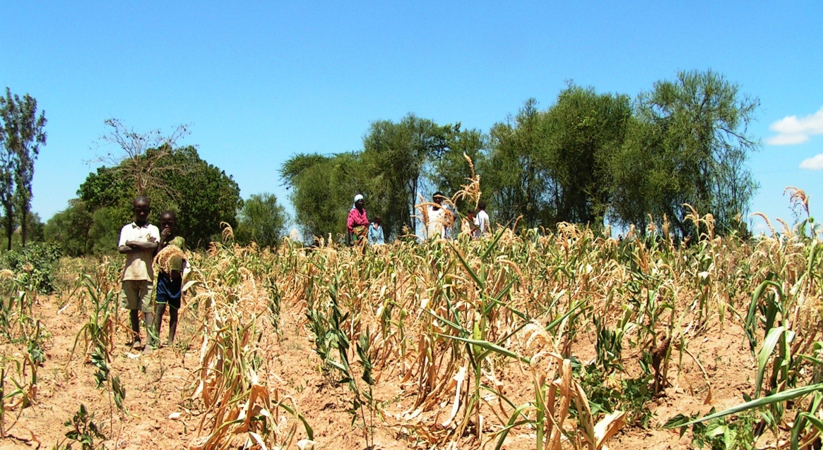
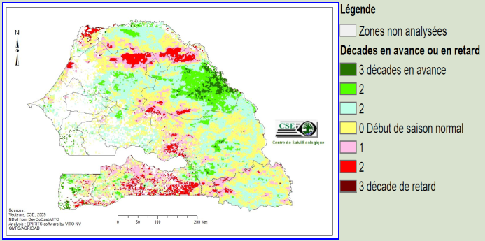
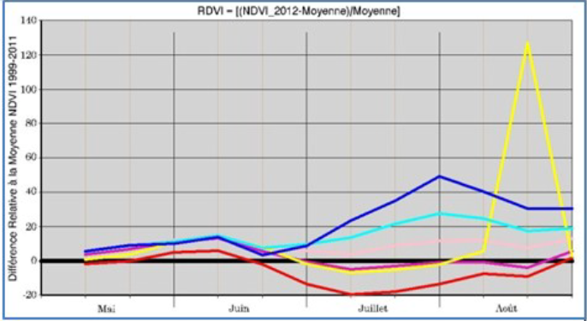
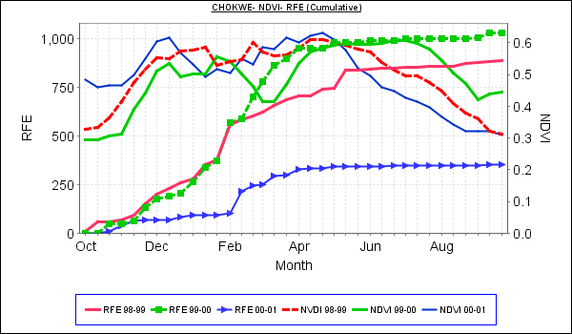
Early warning and crop mapping
Operational (near) real-time monitoring of vegetation status
  Using time series of satellite images
  Improve agro-meteorological bulletins
Qualitative relations between vegetation & weather indicators
  Drought (Kenya, Senegal, Mozambique) / Flooding (e.g. Limpopo Mozambique)
  Assess the impact of climate change and increased climate variability

Slide 15
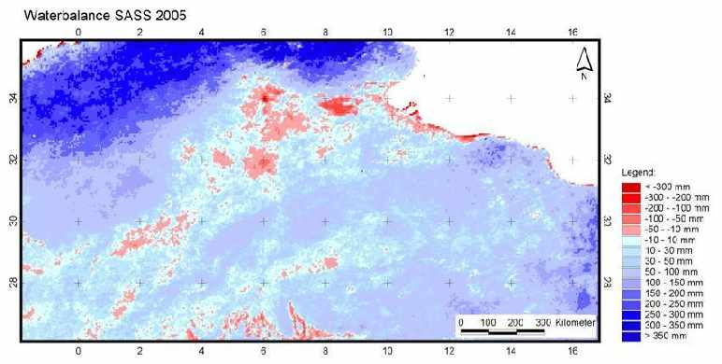
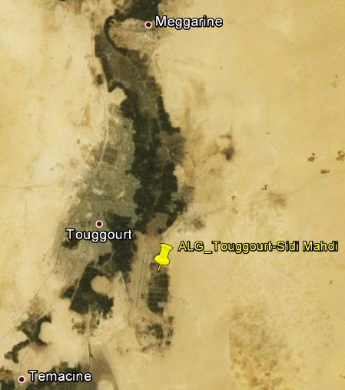
Irrigation agriculture
High water abstraction for irrigated agriculture in North Western Sahara Aquifer System
Monitor land use/land cover changes using EO
Model water abstraction based on crop masks and water requirements, integrate time series of low resolution vegetation indices

Slide 16
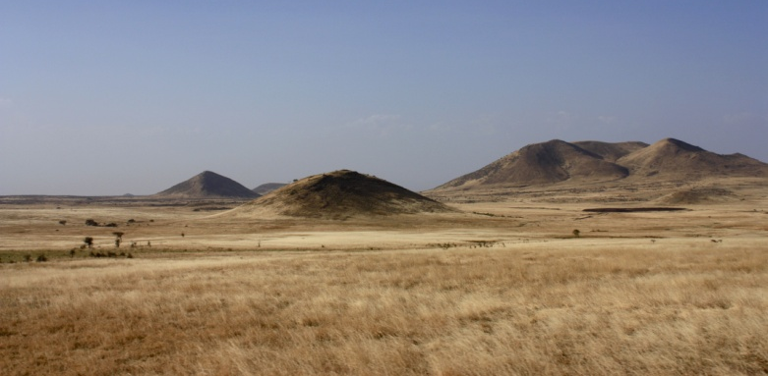
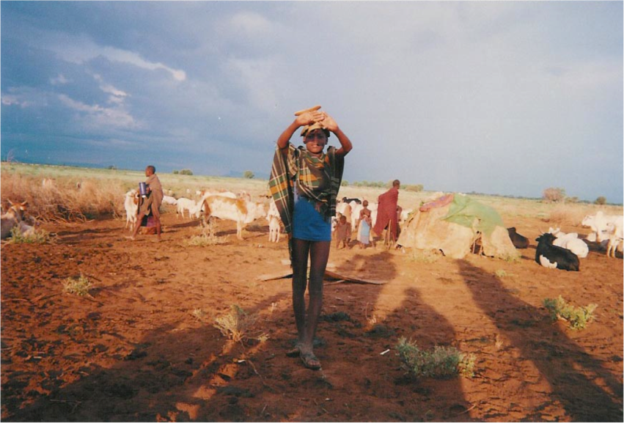
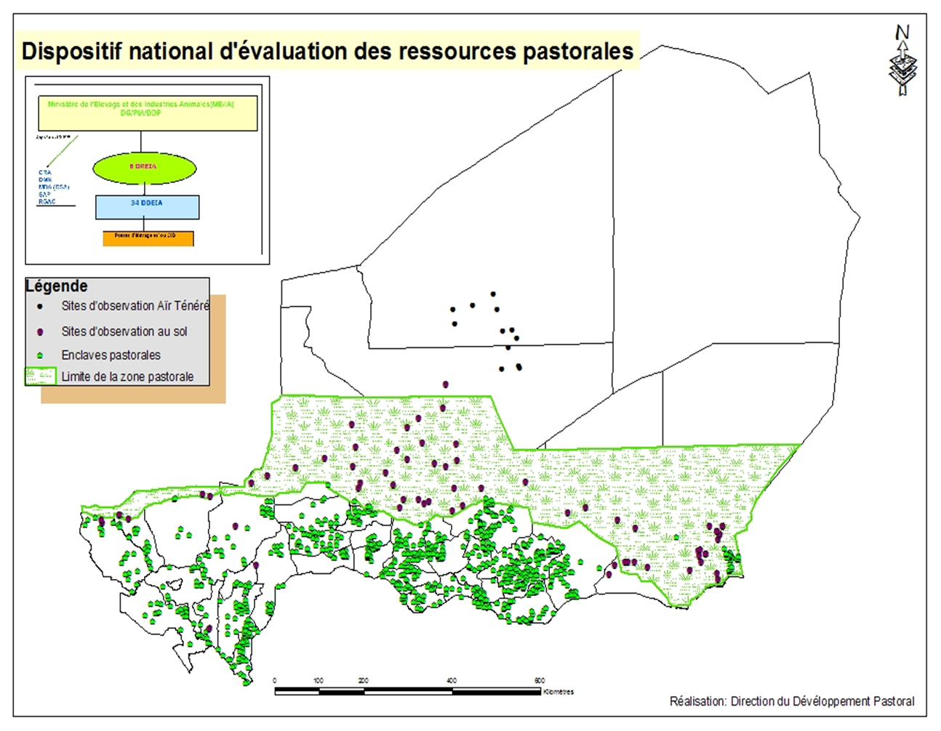




Use cases (2/3): Livestock systems
Operational forage biomass monitoring & modeling for early warning (Senegal, Niger)
Improve Index-based Livestock Insurance (Kenya)
Improved maps of livestock production systems (Continental/Global)

Slide 17
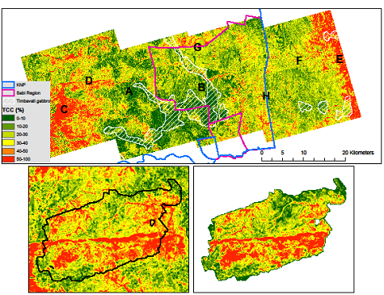
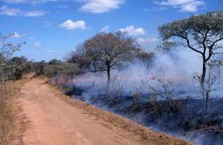
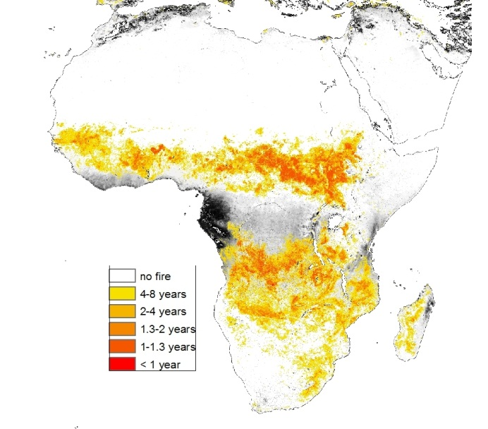

Use cases (3/3): Forest Systems
Generation of tree cover maps for savannah and woodland in Southern Africa
  Sustainable management of ecosystem
  Food security (rangeland capacity) and energy security (charcoal & fuel wood)
Production & dissemination of fire information derived from MODIS in Southern Africa
  Carbon storage and fire management strategies
  Based on MODIS time series
Determine the effects of different land management policies on fire regimes

Slide 18
Contributions/links to GEO WP Tasks
IN-04 – GEONETCast (infrastructure) – EUMETSAT (co-lead)
  Task contributor
  Support the setup of receiving stations
  “land hub” add-on to EUMETCast GNC
  Supply data (SPOT-VGT, CBERS, Landsat?) on GEONETCast
ID-02 – Capacity building
  Task contributor
  Training, software, GNC capacity building, ...
AG-01 – Global Agriculture
GEO CoP-Forest
GEO WS in Africa (2014)
AfricaGEOSS?

Slide 19








Thank you!
Tim Jacobs, Carolien Toté
Flemish Institute for Technological Research (VITO NV), Belgium
Tim.jacobs@vito.be; carolien.tote@vito.be
On behalf of the consortium of 17 Partners from 12 countries:
More information: see http://rs.vito.be/africa

