Slide 1
Challenges and opportunities in developing an E-Infrastructure for Marine Ecosystem Monitoring in the Mediterranean
Gonzalo Malvárez
WP3 leader
University Pablo de Olavide (UPO)
Seville, Spain

Slide 2
The project: goals and main issues
The Medina E-Infrastructure and its components
Challeges and Opportunities

Slide 3
MEDINA Overall objectives
To contribute to the assessment of coastal ecosystem status in North African countries.
To enhance the monitoring capacity for those regions.
To identify major risks due to climate change, thus aiding the development of adaptation strategies.
To feedback MEDINA’s scientific contribution within the EU regulatory framework, as part of the mutual exchange between North Africa and European Countries.

Slide 4
Why an e-infrastructure?
This is one of the main outcomes of the Medina project: the MEDINA e-Infrastructure for facilitating the development and the collaborative work of a Community of Practice (CoP) dealing with ecosystem monitoring (including fisheries) within the Mediterranean marine and coastal areas of North African countries.

Slide 5
Why an e-infrastructure?
To build inventories on the availability and usability of data sources, data processing and chaining service and metadata standards used for describing data.
To demonstrate a real use case exploitation of the GCI a thematic area, via the implementation of selected pilot case studies
The MEI, built in WP3, will act as a tools for visualising data and indicators.
MEDINA e-infrastructure will guarantee viability, compatibility and sustainability with existing databases.

Slide 6
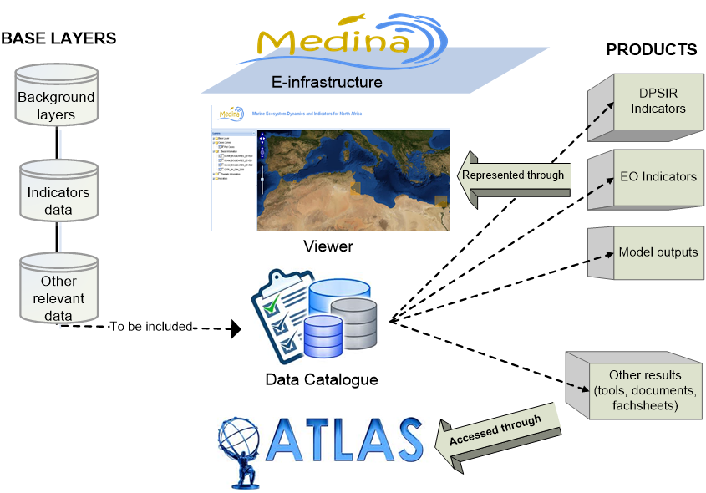
MeI conceptual model

Slide 7
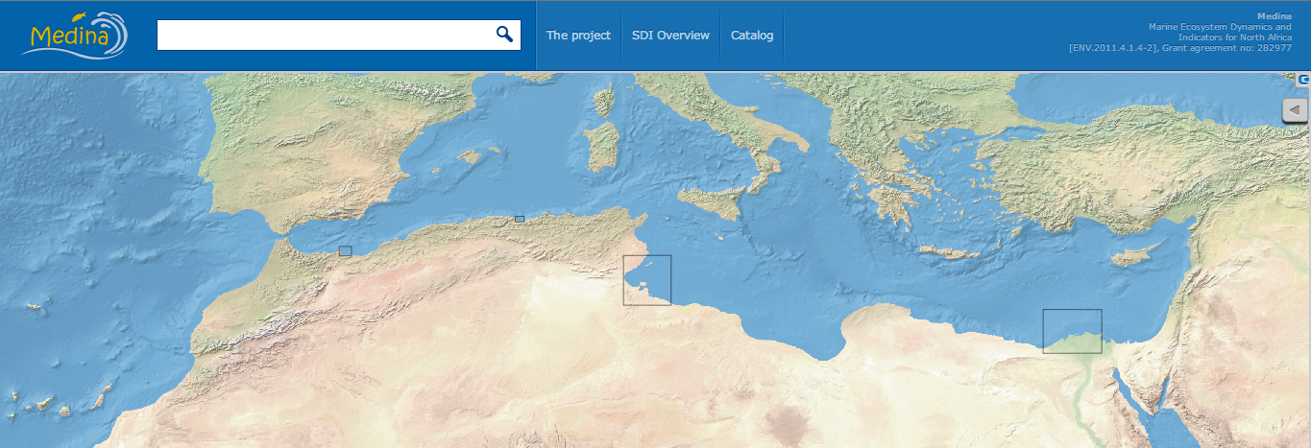
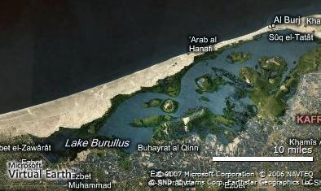
The pilot case in Egypt includes coastal delta lake; Lake Burullus.
The Gulf of Gabes is the gateway between eastern and wetern mediterranean conditions
Lybia
The Nador lagoon, also called Sabkha Bou Areg or Mar Chica, is the second lagoon complex of northern Africa (115 km2)

Slide 8
Main MeI features
From data provider point of view
Standardize metadata creation
Standardize data publication
From user point of view
DISCOVERY → Search for data and metadata
VISUALIZATION → View data and metadata to decide whether they are suitable for partner needs
DELIVERY → Access or download data for analysis or mapping purposes

Slide 9
Issues for MeI construction
Choice of components for MeI:
Catalogue: A key element that in MEDINA is highly problematic due to institutional framework for data management. In situ data availability an issue. A data locator module under development
Viewer: for visualisation of maps and services. The viewer require specific tools and modelling gateway
Atlas: to access a set of predefined maps. Issues defining key map elements
01/02/13
9

Slide 10
How will the MeI work
DATA
Indicators results from PML
Partners
SITES
Access MEI
Indicators results from ACRI
Local
Goverments
Medina e-Infrastructure
Indicator results from UAB
Researchers
Other spatial results from MEDINA
Others
Download, visualise and use maps
Relevant layers from JRC, ESA..
01/02/13
10

Slide 11
Catalogue’s development highlights
Results of the inventory of European and International databases
Analysis of Spatial data standards and harmonization
Inventory and preliminary assessment of the European databases and research projects datasets
Others (umbrella websites/projects/databases)

Slide 12
Catalogue’s development highlights
A set of software tools able to detect on demand the availability of in situ and satellite data on selected geographic areas which give the possibility to quickly and remotely retrieve information about how many and which environmental data are available in a given geographic area. It allows for running quick comparisons on data availability over different geographic areas.
The data used so far are in prototype:
footprints of ENVISAT/MERIS
in situ oceanographic parameters
aquatic species distribution
EUSeaMap seabed habitat: layer created using three pre-processed input datasets: substrate, biological zone and energy
Bathymetry: GEBCO_08 Grid: global 30 arc-second grid (900m resolution)

Slide 13
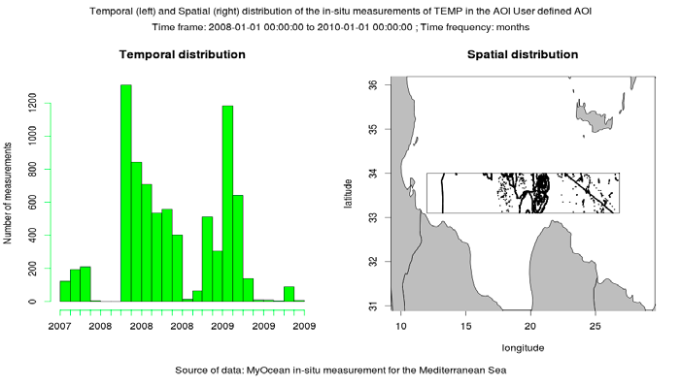
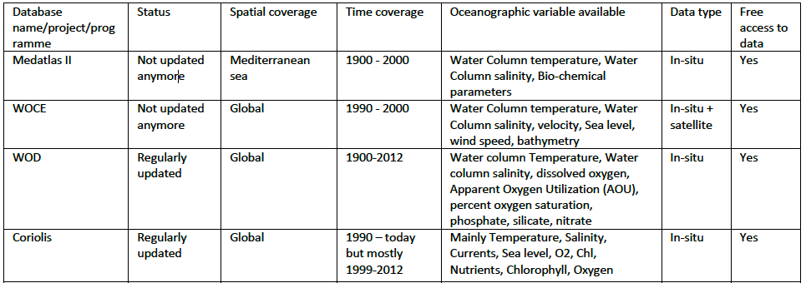
Catalogue’s development highlights

Slide 14
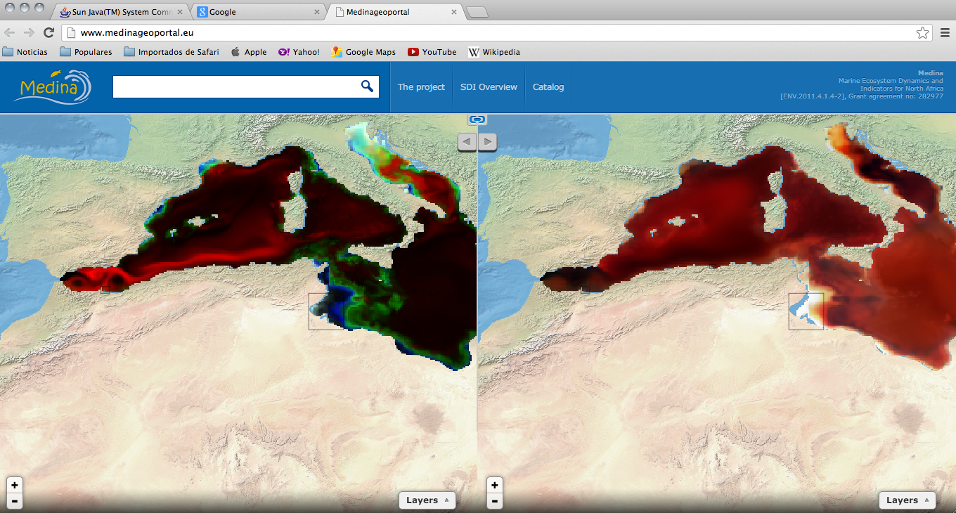
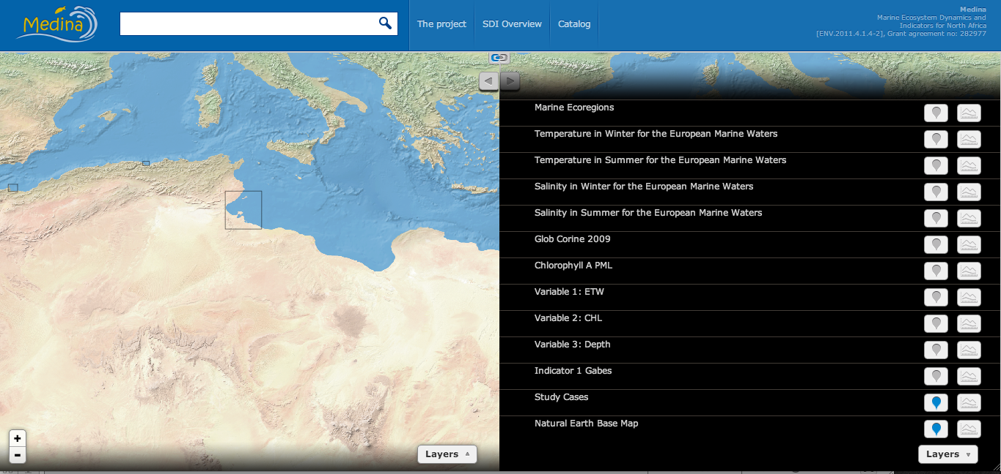
Viewer development highlights

Slide 15
Task 3.1 MEDINA e-infrastructure (M2-36).
Implementation of MEI (M12-36) (UPO)
First indicators into the MEI:
An indicator of the Nador lagoon (provided by ACRI) has been transformed into WMS and uploaded into the MeI.
Some indicators based on Chlorophyll and other variables (provided by PML) have been transformed into WMS and uploaded into the MeI .
Results are already available and visible through the MeI
An first analysis on models integration into the MeI was done.
A Training session was perfomed in Frascati (feb 2013)
A draft of a Guidelines for indicator construction created:
Format (geotiff), projection, legend.
A template for metadata files created
15

Slide 16
The Atlas
It’s a key tool to support decision making in MEDINA
It allows the access to data in an effective way (non computer skills needed)
It will be the “real world” tool for Ecosystem monitoring: more comprehensive
It needs the previous definition of MEDINA products

Slide 17
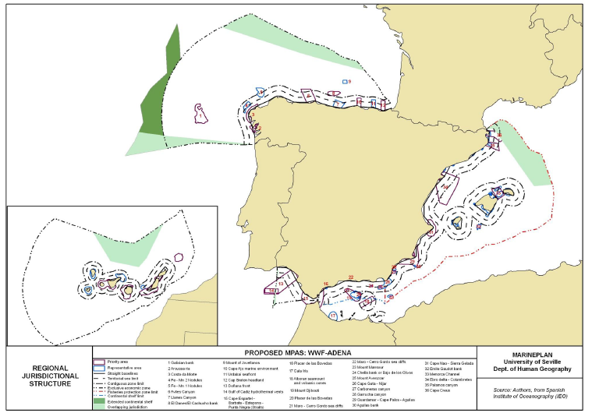

Slide 18
The Atlas
What we envisage for Atlas
1) An online tool that combines interactive maps with text and images, organized in different sections or topics.
2) The tool should make possible for a user to create and modify those sections and its contents, from an administration interface, without requiring any programming skills.

Slide 19
Using the Atlas
Different user profiles will be defined:
Editor user: edits and prepares the main maps, legends and descriptive texts fro each atlas content (factsheet). WP3 will lead this task.
Partner user: create new services (layers) from local data or modify factsheets. Local geonodes developers, some partners and indicators builders are responsible for this task.
General user: visualise atlas outputs (maps, factsheets), customize the display of maps from pre-defined cartographic products. Consortium partners, end-users and general public.

Slide 20
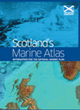
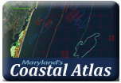
The Atlas
It will follow other international initiatives in the field such as the International Coastal Atlas Network
Title of presentation – YYYY.MM.DD
Author / Partner Code (Country)
20

Slide 21
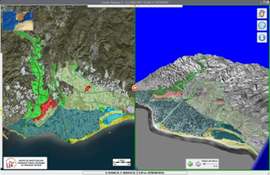
Opportunities
The Geoportal contains the main output from MEDINA (indicators) and other relevant products from other clients (JRC, EEA, ESA, MARCOAST).
A Geoportal for Marine Ecosystem indicators for NA
It will facilitate the visualisation, comparison, and spatial analysis activities:
Tools for editing, comparison, getinfo and downloading
01/02/13
21

Slide 22
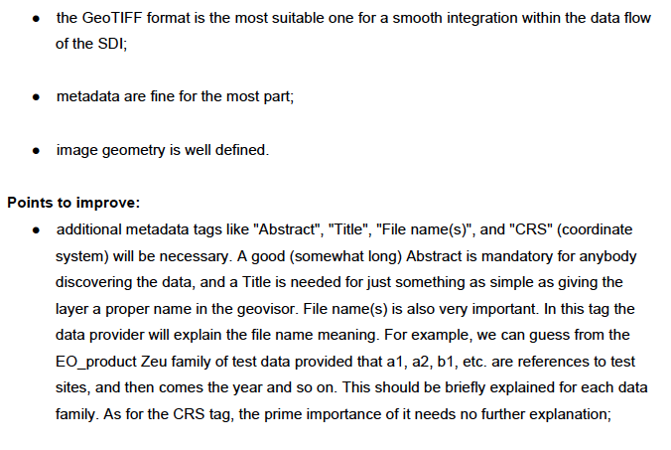
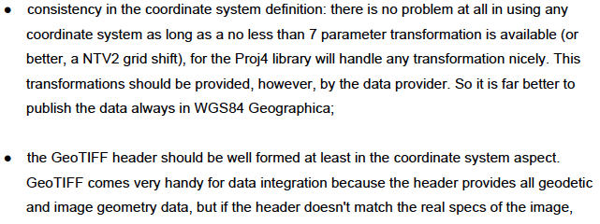
Integrating Indicators
01/02/13
22

Slide 23
How do we integrate indicators?
01/02/13
23

Slide 24
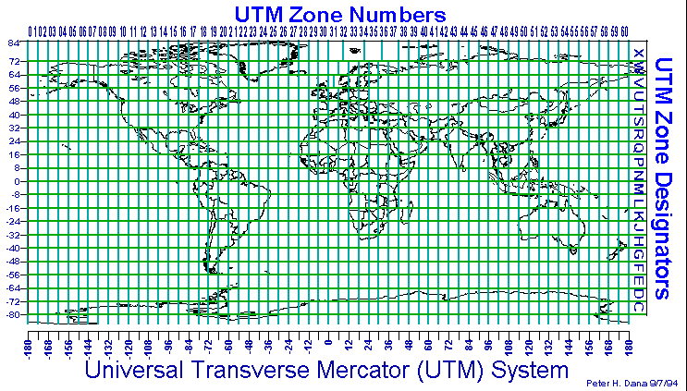
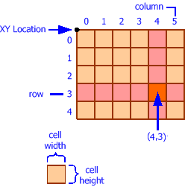
Challenges
Precise resolution, indicating process of interpolation if needed that may have affected geometry of the image/map.
Precise pixel size, and shape (x and y dimensions if irregular).
01/02/13
24

Slide 25
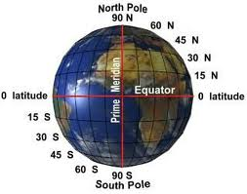
Challenges
Definition of Indicators and models: Factsheets
Indicators results need to have a spatial output:
Indicator output should be geotiff o NETCDF.
Precise geographic locations (full lat/long coordinates) of image corners, indicating the reference coordinate system (e.g. WGS84).
An adaptation to OpenDAP and DoDS, which are the common EO formats of NCAR and NOAA
01/02/13
25

Slide 26
Challenges
Indicators results need to have metadata:
Metadata refers to summary coordinate system, provider, user constrains, resolution, among others.
It will help to search data, and to know relevance usability for users/researchers.
01/02/13
26

Slide 27
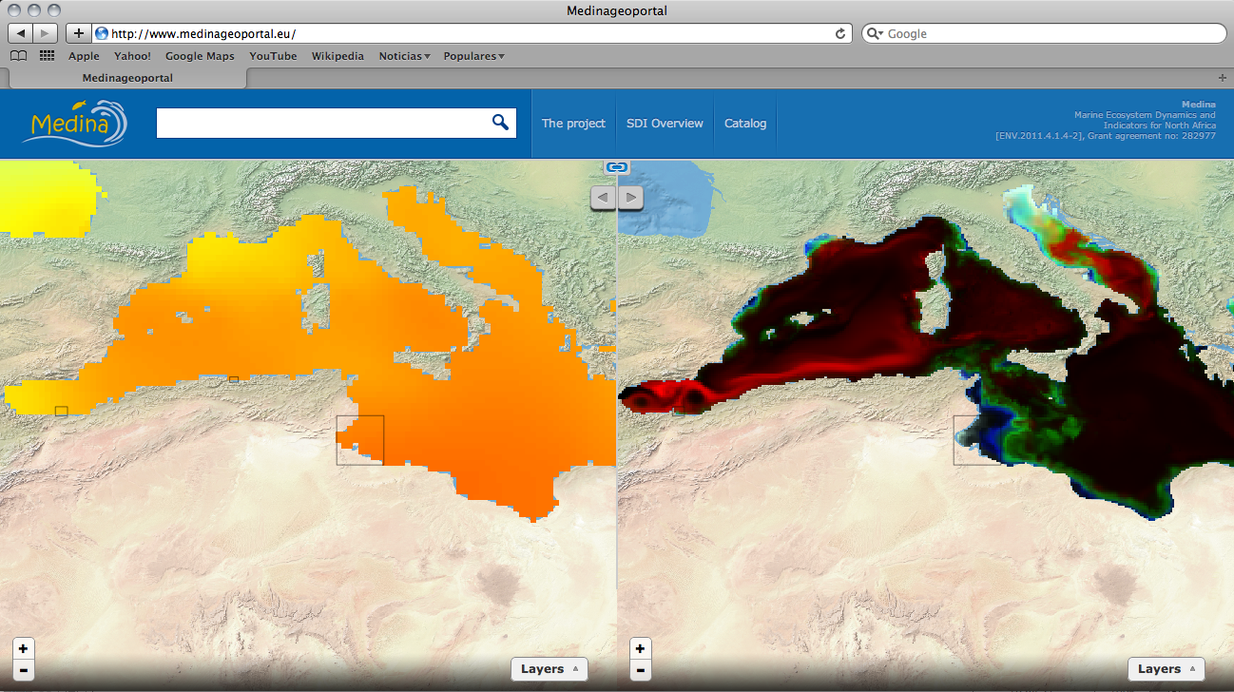
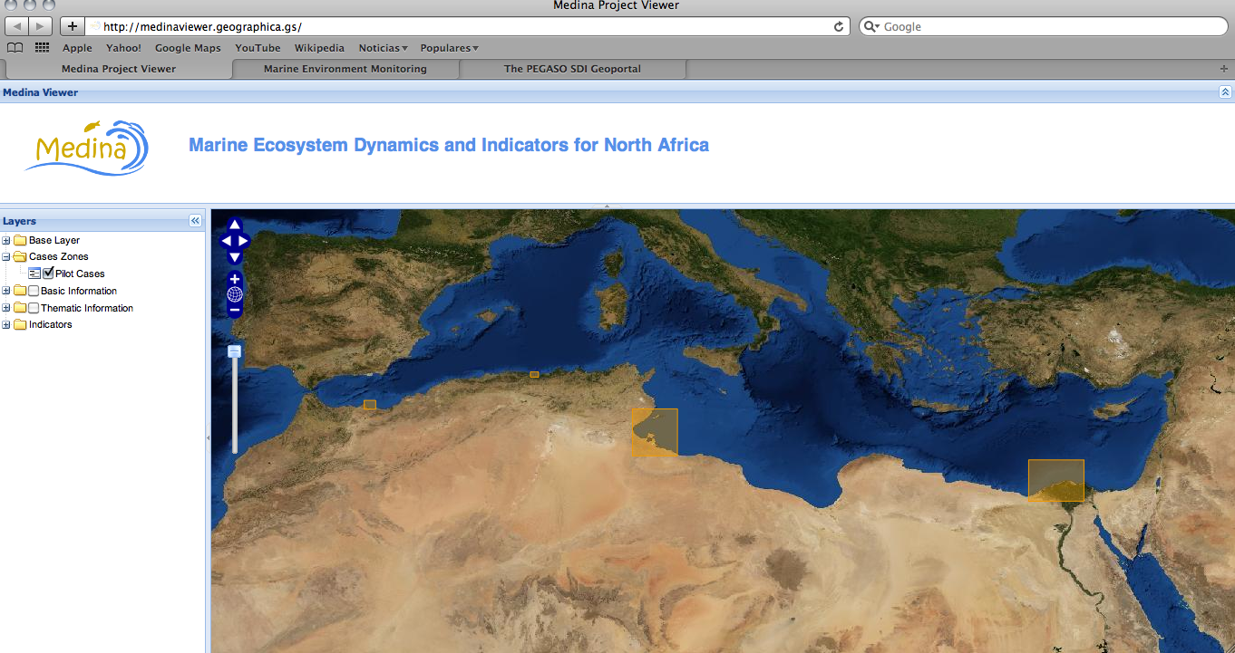
Status of the MeI
Catalogue Viewer Atlas
01/02/13
27

Slide 28
MEDINA Project
Thanks!
Gonzalo Malvárez
WP3 Leader
University Pablo de Olavide
Seville, Spain.

