Slide 1
Data discovery and data processing for environmental research infrastructures
Roberto Cossu
ENVRI WP4 leader
ESA

Slide 2
Outline
The communities and the data in the project
Discover the data
Process the data
Linked data

Slide 3
Environmental Science
long-term development of the climate system
Biological processes
biodiversity
development of the cryosphere and lithosphere
oceanic and atmospheric processes
Earth as a single complex and coupled system

Slide 4
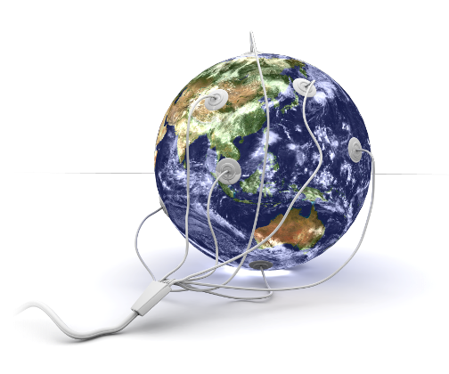
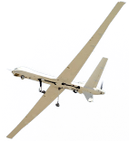
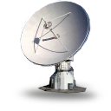
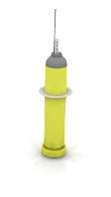
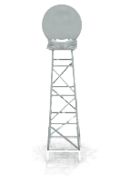
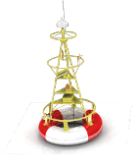
Goal
Enable multidisciplinary scientists to access and study data from multiple domains for “system level” research
by providing solutions and
guidelines for the RIs
common needs
Multiple data producers
Multiple data consumers

Slide 5
ESFRI Environmental Research Infrastructures
COPAL
Tropospheric research aircraft
EISCAT-3D
Upgrade of incoherent SCATter facility
EMSO
Multidisciplinary seafloor observatory
EPOS
Plate observing system
EURO-ARGO
Global ocean observing infrastructure
IAGOS
Aircraft for global observing system
ICOS
Integrated carbon observation system
LIFEWATCH
Biodiversity and ecosystem research infra
SIOS
Svalbard arctic Earth observing system

Slide 6
Discover heterogeneous data at different places and in different catalogues.
Distributed measurements and monitoring
• physical, chemical and biological parameters
Laboratories and experimental facilities
• in fixed monitoring stations
• on research vehicles, ships, floats and buoys
• from aircraft and satellites
A variety of data
• heterogeneous in format
• primary and processed data
Analytical and modeling platforms
• data exchange and integration
• high performance computing and Grid services
• e-Laboratories

Slide 7
First steps - priority areas
Integrated data discovery across various centres / catalogues
(near) Real-time data handling
Federation over existing (national or international) infrastructures / services

Slide 8
Approach
Promote Accessibility
discover data which are heterogeneous in format, content, and metadata description
Preserve Specificity
harmonise, integrate and analyse data across domains and RIs
Provide software tools to

Slide 9
Study cases
They are needed for:
Identify data
Tune/evolve “basic” services, e.g., discovery, access
Develop “more complex” services , e.g, visualization
Integrate Processing services (availability of SW)
Two regions:
The iceland Volcano:
ICOS, EISCAT, EuroArgo, satellite images, ( + DLR/”IAGOS-like”)
South Italy:
Lifewatch, EPOS, EMSO, EuroArgo, Italian ISPRA environmental data
EMSO, EPOS

Slide 10
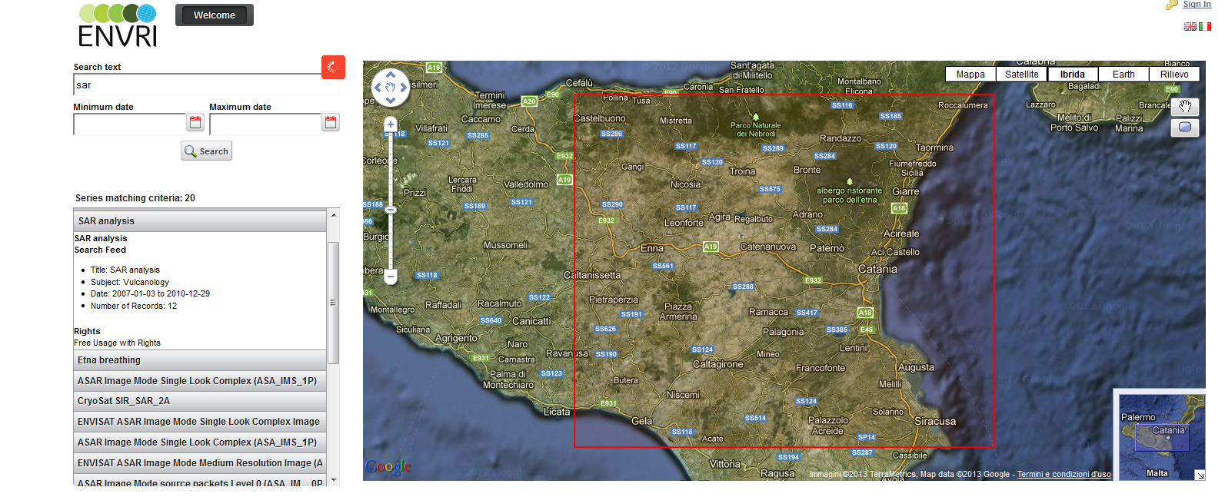
Dataset Discovery
Insert the text string and set the specific parameters
Insert Start Date and Stop Date
Click on Search to start the query
Set the bounding box as desired
Collection of data corresponding to the search criteria are listed here.

Slide 11
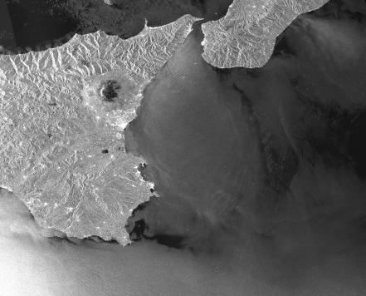
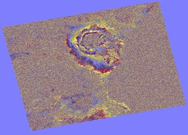
Data discovery example
Query of heterogeneous data based on geo-spatial and temporal criteria defined by the user
Satellite data
In- Situ data
Interferograms computed from data
(either on demand computation or discovery of previously generated products)

Slide 12
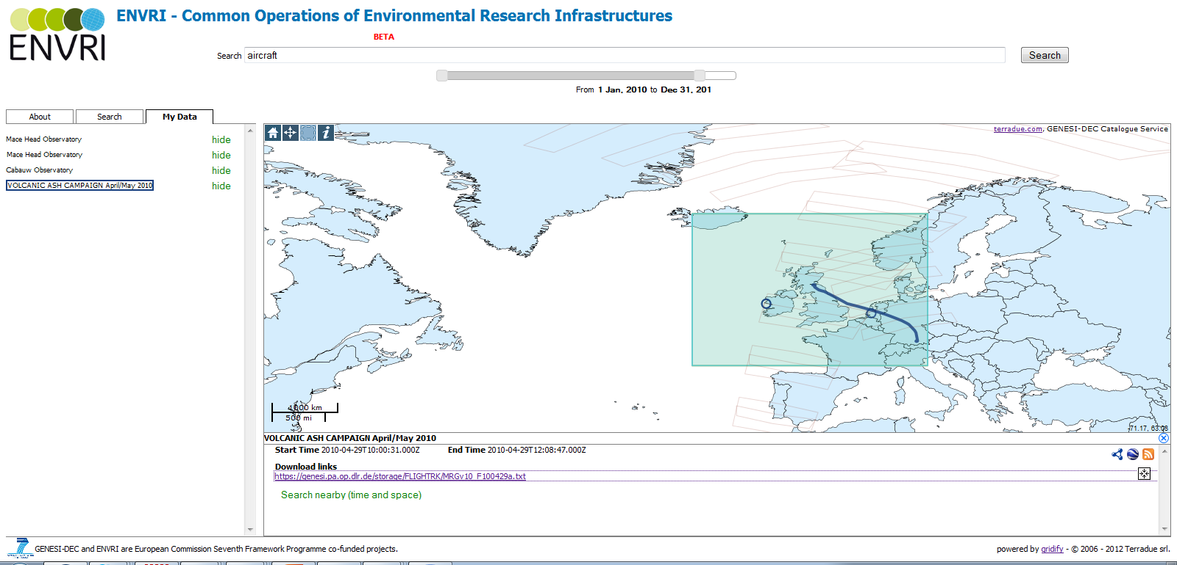
Study case: Iceland volcanic ash (2010)
Envisat Sciamachy atmospheric data
Measures from airborne sensor (DLR-IAGOS)
In situ data from ICOS Demo Atmospheric Network

Slide 13
Discovery Service: OpenSearch
The discovery services is based on GENESI-DEC approach.
The catalogues of the different repositories expose an OpenSearch-based interface by which data can be discovered and accessed through external applications
OpenSearch is a collection of technologies allowing websites and search engines to publish search results in a standard and accessible format
Search engines are described through OpenSearch Description Documents

Slide 14
Full ENVRI workflow for geospatial Data Services
Data Access
Data Process
OGC
WCS
OGC
WPS
THREDDS
WPS 52N
P1
P2
P..
WPS Hadoop
Data Discovery
Data Pub. /Vis.
OGC
OpenSearch
Linked Open Data
gCube Data staging
Hadoop Cluster
OGC
WMS, WFS
HDFS
Catalogue
Services
GeoServer
Geospatial Repositories
by courtesy of P. Pagano (ISTI-CNR)
Data Processing. Models and statistical analysis tools based on the requirements to be gathered from multi-disciplinary study cases

Slide 15
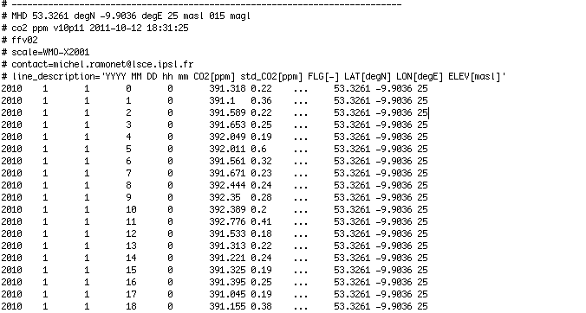
Linked data
METADATA
(parameter, unit of measure,
instrument, provider, ...)
OBSERVATIONS
DATASET
DIMENSIONS
(time, lat/long, elevation)
Notes:
Data modeling is the most challenging step of the Linked Data publication. Future data reusability and interoperability depends on the decisions made during the modeling process.
How do we model environmental data? Environmental data is a collection of measurements. We can think of it as a multidimensional space filled in with environmental observations. In order to locate each observation in the space we need to know the dimensions' values of the observations. It can be the timestamp, when the observation was collected, the geographical location of the place, where the observation was taken, or the elevation of this place. Other important information that we need in order to correctly interpret the data includes such information as the measured parameter (e.g., CO2), the unit of measure (e.g., ppm) or the provenance information (e.g., the data provider). This information (metadata) is common for all the observations of the dataset.

Slide 16
Linked Data
Modelling ENVRI data with the Data Cube vocabulary
The Data Cube vocabulary provides a generic framework to encode collections of observations.
This vocabulary was developed for the statistical domain and based on the SDMX standard
Analyze
Model
Publish
Use
Notes:
In general, the activities involved into the process of the Linked Data publication include:
1. Analysis of the data (extract concepts of interest).
2. Data modeling in RDF (re-use the existing RDF vocabualries).
3. Definition of the publishing pattern (e.g., how the data should be transformed into RDF, what storages should be used, what alternative data access should be provided).
4. Using Linked Data (e.g., mashups and visualizations).

Slide 17
Thank you
http://envri.eu/

