Slide 1



Ground measurements, satellite observations and simulations of soil moisture over the Tibetan Plateau
Rogier van der Velde
Faculty of ITC, University of Twente
The Netherlands
www.itc.nl/wrs
e-mail: r.vandervelde@utwente.nl
with contributions from:
Z. Su, Y. Zeng, Z. Vekerdy, L. Dente
J. Wen, Y. Ma, K. Yang

Slide 2
Outline
Project relevance and focus
Ground measurements (Tibet-Obs)
Soil moisture mapping
  Regional-scale
  Plateau-scale
Link with model simulations
Summary

Slide 3
Project relevance and research focus
Projects:
  FP-7 CEOP-AEGIS (Prof. Menenti)
  FP-7 CORE-CLIMAX (see talk Y. Zeng)
  ESA-NRSCC Dragon-3 programme
    SMOS and Sentinel-1 Cal/Val
    CEOP-Third Pole Environment
  Research Fund for International Young Scientists from the National Natural Science Foundation of China (NSFC)
  Basic Research Development (so-called ‘973’) Program of China (K. Yang)
Research approach focuses on:
  Measuring, remote sensing and modeling the land surface states (soil moisture, temperature, vegetation) and heat fluxes (latent, sensible);
  Soil moisture remote sensing (i.e. ASAR, Sentinel-1, SMAP, ASCAT, AMSR, SMOS);
  Land surface modeling and data assimilation;

Slide 4
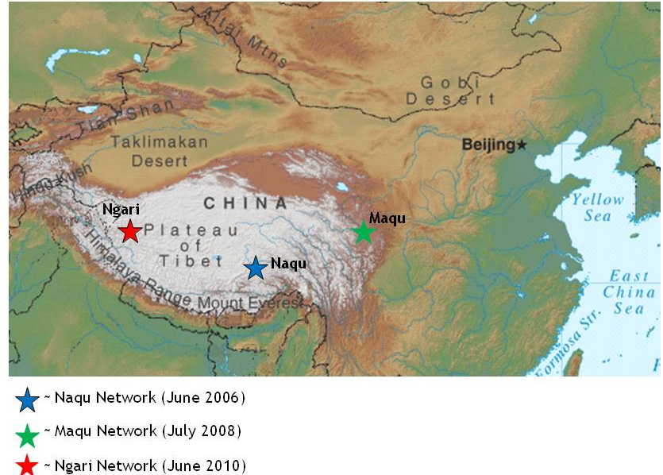
Tibet-Obs
Tibetan Plateau soil moisture and soil temperature observatory
Su et al. HESS (2011)

Slide 5
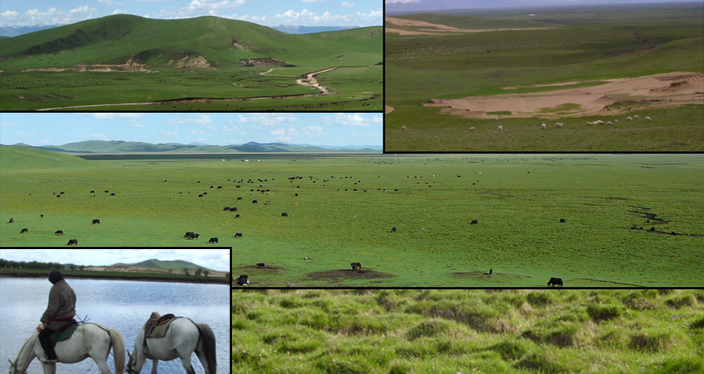
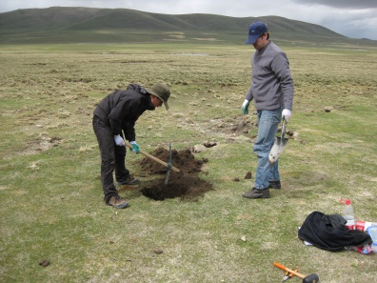
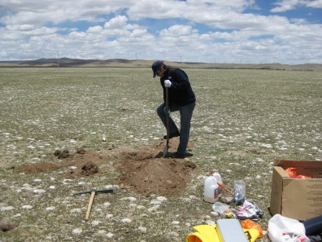
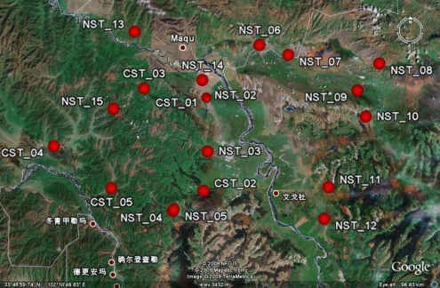
Site characteristics (Tibetan networks)
Naqu network (+ 4500 m), since 2006:
Semi-arid (250 - 450 mm rain), affected by Asian Monsoon;
7 stations (ITC), + 40 stations (ITP): 1x1º box, UL: 32.0 N, 91.5 E;
Grasslands and wetlands;
GEWEX: CAMP, GAME/Tibet’s
ITP’s: meso-scale network
Maqu network (+ 3200 m), since 2008:
Semi-arid (450 - 900 mm rain);
20 stations (CAREERI/ITC, L.Dente):
80 x 40km box, UL: 34.0 N, 101.5 E;
CAREERI: PBL tower site
Head waters of the Yellow river
Notes:
Put coordinates

Slide 6
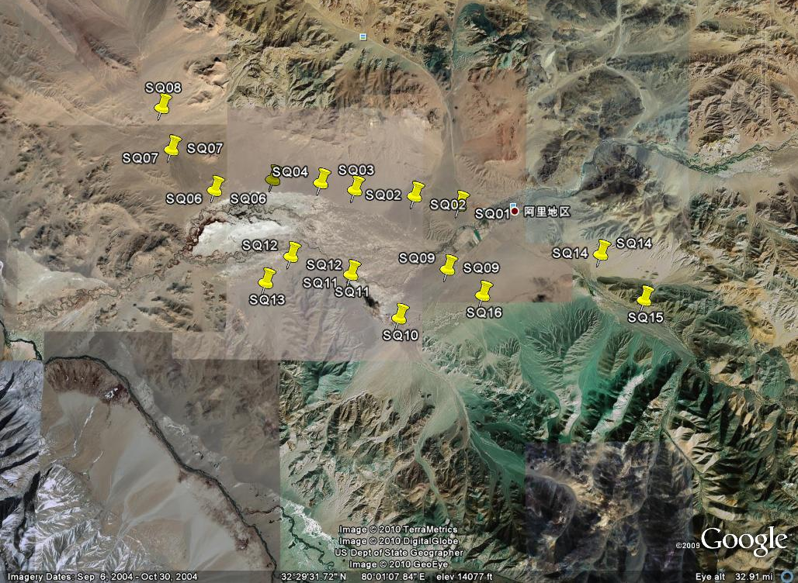
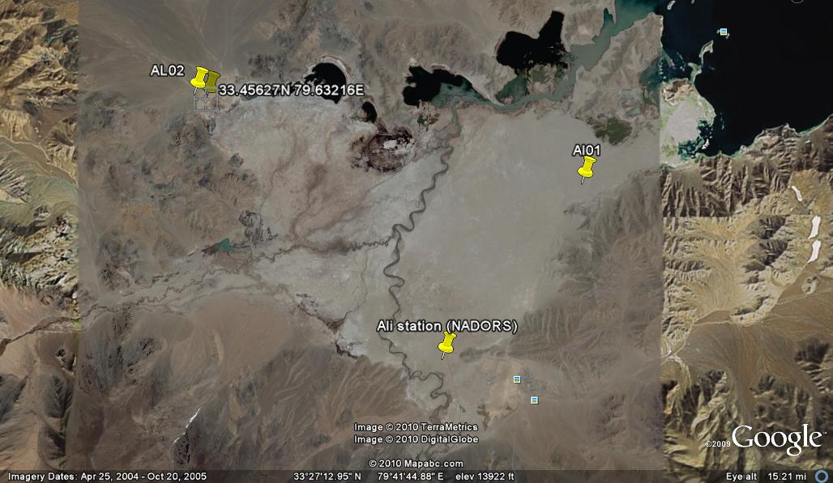
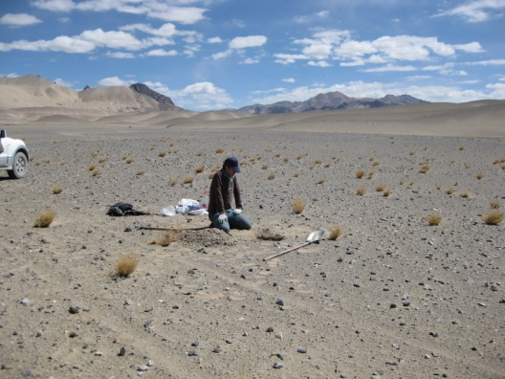
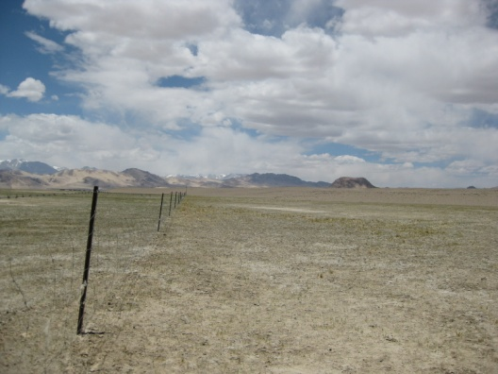
Site characteristics
Ngari network (+ 4200 m), since 2010:
Arid (100 - 250 mm rain)
16 station near Shiquanhe (Indus): 30 x 40 km, UL: 32.5 N, 79.8 E;
4 station near Pangang Tso Lake: 10 x 10 km,
UL: 33.5 N, 79.8 E;
Wet riverbed of the Indus and desert envirn.
GEWEX: CAMP, GAME/Tibet’s

Slide 7
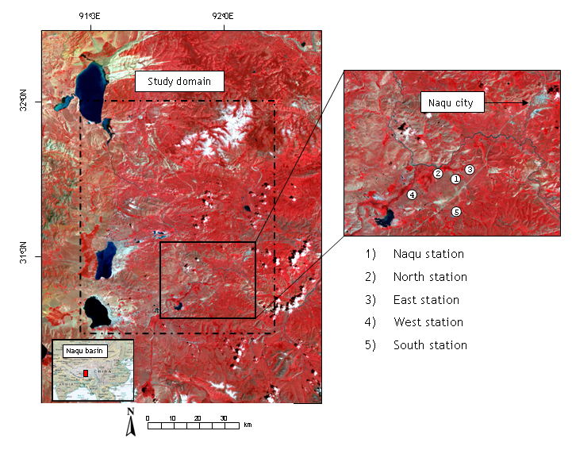
Soil moisture mapping
Regional-scale soil moisture mapping using Synthetic Aperture Radar (SAR) as demonstrator for the future Sentinel-1 SAR capabilities
Nagqu ASAR WS data set
Polarization: VV
Number of scenes: 150 #
Period: April 2005 –July 2007
Temporal resolution: 6 days
grassland
wetland

Slide 8
Soil moisture maps
Monsoon seasons 2005 and 2006
Van der Velde et al. RSE (2012)

Slide 9
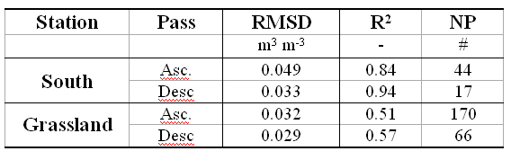
Measurements vs. Retrievals

Slide 10
Soil moisture monitoring
Plateau-scale soil moisture monitoring is possible with a variety setups:
Microwave radiometers (e.g. SMOS, AMSR, TMI, SSM/I),
Scatterometers (e.g. ERS-SCAT, ASCAT),
Land modelling solutions (e.g. GLDAS, ECMWF).
Su et al. (in preparation)

Slide 11
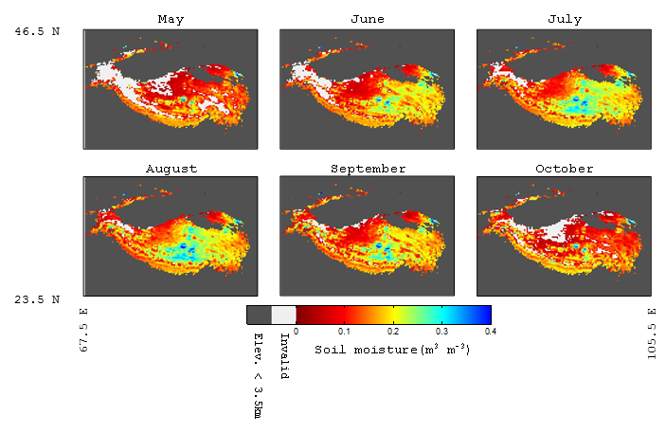
Soil moisture monitoring
Satellite based soil moisture climatology

Slide 12
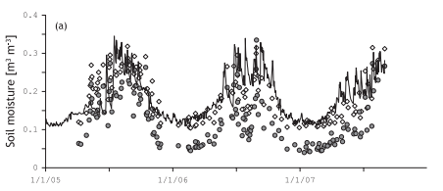
Satellite observations vs. model simulations
ASAR vs. MM5-Noah
Date (m/d/yy)

Slide 13
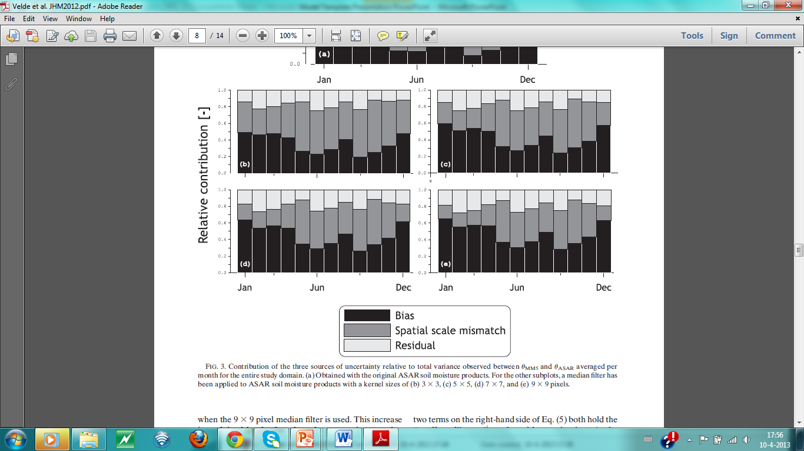
Satellite observations vs. model simulations
Mismatch between satellite observations and model simulations are created by,
Imperfect retrieval and model applications;
Biases between climatologies;
Scale differences
Relative uncertainty
Van der Velde et al. JHM (2012)

Slide 14
Summary
The Tibetan Plateau soil moisture and soil temperature observatory (Tibet-Obs) has been developed and is operational;
Satellite observations have used to map/monitor at regional- and plateau-scale;
Overall the soil moisture dynamics of ground measurements, satellite observations and model simulations are consistent;
Bias in climatologies and spatial scale mismatch are the two most important sources for differences between (satellite) observations and model simulations.
Future work:
Develop a Fundamental Climate Data Record for soil moisture
Develop an Sentinel-1 SAR soil moisture product.

Slide 15
Thank you and questions ...
Su, Z., Wen, J., Dente, L., van der Velde, R., Wang, L., Ma, Y., Yang, K., and Hu, Z. 2011, The Tibetan Plateau observatory of plateau scale soil moisture and soil temperature (Tibet-Obs) for quantifying uncertainties in coarse resolution satellite and model products, Hydrol. Earth Syst. Sci., 15, 2303–2316, 2011, www.hydrol-earth-syst-sci.net/15/2303/2011/, doi:10.5194/hess-15-2303-2011.
Dente, L., Vekerdy, Z., Wen, J. and Su, Z., 2012, Maqu network for validation of satellite - derived soil moisture products. Int. J. Applied Earth Observation and Geoinformation : JAG, 17 (2012) pp. 55-65.
Dente, L., Su, Z. and Wen, J., 2012, Validation of SMOS soil moisture products over the Maqu and Twente regions. Sensors, 12, 9965-9986.
Su, Z., P. de Rosnay, J. Wen, L. Wang, Y. Zeng, 2013, Ability of the ECMWF 1 model in simulating and analysis of root zone soil moisture on the Tibetan plateau , JGR (in revision)
van der Velde, R., Z. Su, and Y. Ma, 2008, Impact of soil moisture dynamics on ASAR signatures and its spatial variability observed over the Tibetan plateau. Sensors, 8(9),5479-5491.
van der Velde, R., Z. Su, 2009, Dynamics in land surface conditions on the Tibetan Plateau observed by ASAR, Hydrol. Sci. j., 54(6), 1079-1093.
van der Velde, R., Z. Su, M. Ek, M. Rodell, and Y. Ma, 2009, Influence of thermodynamic soil and vegetation parameterizations on the simulation of soil temperature states and surface fluxes by the Noah LSm over a Tibetan plateau site, Hydrology and Earth System Sciences, 13, 759-777.
van der Velde, R., Salama, M.S., van Helvoirt, M.D. and Su, Z. (2012) Decomposition of uncertainties between coarse MM5 - Noah - Simulated and fine ASAR - retrieved soil moisture over Central Tibet. J. hydrometeorol., 13 (6), 1925-1938.
van der Velde, R., Su, Z., van Oevelen, P., Wen, J., Ma, Y. and Salama, M.S. (2012) Soil moisture mapping over the central part of the Tibetan Plateau using a series of ASAR WS images. Remote sens. Environ., 120,175-187.

Slide 16
Measurements vs. Retrievals

